Slide 1

Assignment 03 : Implement microservice backend for the minimal viable product (MVP) IT4020 - Modern Topics in IT Year 4, Semester 1 (2023) – Weekend Batch
Sri Lanka Institute of Information Technology

Slide 2
Group Details
Group ID - MTIT-011
Project Name - Implement microservice backend for the minimal viable product (MVP) Our business domain is Dialog Axiata company
Batch - 2023 -Y4S1
Registration Number | Student Name
IT20147396 | Peiris B M G
IT20178154 | Dilshan P A D S D
IT20081416 | Ahamed M M Z
IT20122782 | Amani M P N

Slide 3
Student Contribution
Registration Number | Student contribution
IT20147396 | Shop Manager can ADD communication items. Shop Manager can VIEW communication items. Shop Manager can UPDATE communication items. Shop Manager can DELETE communication items.
IT20178154 | Supplier can ADD supplier menu. Supplier can VIEW the supplier menu. Supplier can UPDATE supplier menu. Supplier can DELETE supplier menu.
IT20122782 | Storekeeper can ADD storekeeper menu. Storekeeper can VIEW the storekeeper menu. Storekeeper can UPDATE storekeeper menu. Storekeeper can DELETE storekeeper menu
IT20081416 | Delivery person can ADD delivery items. Delivery person can VIEW delivery items. Delivery person can UPDATE delivery items . Delivery person can DELETE delivery items .

Slide 4
The Scenario
Our business domain is Dialog Axiata company
Dialog Axiata is a Sri Lankan telecommunications company that provides mobile, fixed-line, and broadband services to customers in Sri Lanka. The company has embraced microservices and cloud computing as a way to deliver services more efficiently and effectively.Dialog Axiata has implemented a number of microservices, including Manager API, Storekeeper API, Supplier API, and Delivery Person API. Each microservice has a specific role and set of responsibilities:
Storekeeper API microservice: This microservice provides a set of RESTful endpoints to manage inventory-related resources, such as stock levels, product information, and order fulfillment. The Storekeeper API microservice helps to optimize inventory management processes, reduce costs, and improve customer satisfaction.
Supplier API microservice: This microservice provides a set of RESTful endpoints to manage supplier-related resources, such as supplier information, purchase orders, and payment processing. The Supplier API microservice helps to streamline supplier management processes and improve the efficiency of the procurement process.
Manager API microservice: This microservice provides a set of RESTful endpoints to manage employee-related resources, such as employee information, work schedules, and performance reviews. The Manager API microservice helps managers to efficiently manage their teams and improve employee productivity.
Delivery Person API microservice: This microservice provides a set of RESTful endpoints to manage delivery-related resources, such as delivery orders, delivery schedules, and delivery routes. The Delivery Person API microservice helps to optimize delivery management processes, improve delivery performance, and enhance the overall customer experience.
To implement these microservices, Dialog Axiata has also adopted cloud computing technologies, such as containerization, Kubernetes, and cloud-based databases. These technologies enable Dialog Axiata to deploy and manage microservices more efficiently and cost-effectively, while also providing scalability, reliability, and high availability.

Slide 5
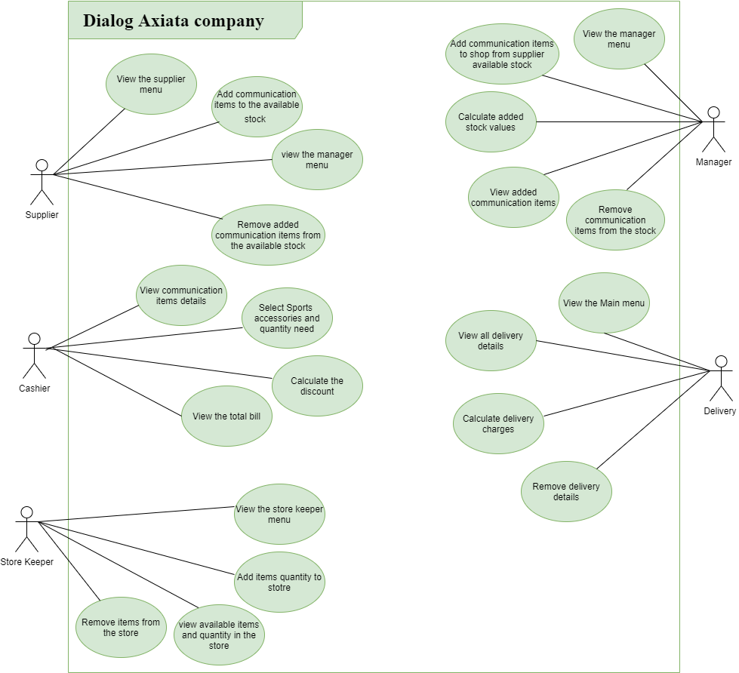
System Diagram

Slide 6
Define and elaborate the microservices
Sports Delivery service
1.Define the scope and functionality of the Delivery Person API microservice:
Identify the delivery-related resources that the microservice will manage.Define the CRUD operations that will be supported by the microservice for each resource.Specify the input and output parameters for each operation.
2.Design the architecture of the Delivery Person API microservice:
Choose a programming language and framework to build the microservice.Define the data models for the delivery-related resources that will be managed by the microservice.Decide on the data storage mechanism for the microservice (e.g., relational database, NoSQL database, in-memory cache).
3.Implement the Delivery Person API microservice:
Write the code for the RESTful endpoints that will handle the requests from clients.Implement the business logic for each endpoint.
Integrate the microservice with any necessary external services (e.g., delivery management systems, authentication and authorization services).
4.Test and deploy the Delivery Person API microservice:
Write test cases for each endpoint to ensure that the microservice functions as expected.Deploy the microservice to a production environment.Monitor the performance of the microservice and make any necessary improvements.
5.Document the Delivery Person API microservice:
Create API documentation that describes the endpoints, input/output parameters, and error codes.Provide examples of how to use the API.Publish the documentation to a centralized location for developers to access.

Slide 7
Sports Supplier service
1.Define the scope and functionality of the Supplier API microservice:
Identify the supplier-related resources that the microservice will manage.Define the CRUD operations that will be supported by the microservice for each resource.Specify the input and output parameters for each operation.
2.Design the architecture of the Supplier API microservice:
Choose a programming language and framework to build the microservice.Define the data models for the supplier-related resources that will be managed by the microservice.Decide on the data storage mechanism for the microservice (e.g., relational database, NoSQL database, in-memory cache).
3.Implement the Supplier API microservice:
Write the code for the RESTful endpoints that will handle the requests from clients.Implement the business logic for each endpoint.Integrate the microservice with any necessary external services (e.g., supplier databases, authentication and authorization services).
4.Test and deploy the Supplier API microservice:
Write test cases for each endpoint to ensure that the microservice functions as expected.Deploy the microservice to a production environment.Monitor the performance of the microservice and make any necessary improvements.
5.Document the Supplier API microservice:
Create API documentation that describes the endpoints, input/output parameters, and error codes.Provide examples of how to use the API.Publish the documentation to a centralized location for developers to access.

Slide 8
Sports Manager service
1.Define the scope and functionality of the Manager API microservice:
Identify the resources that the microservice will manage.Define the CRUD operations that will be supported by the microservice for each resource.
Specify the input and output parameters for each operation.
2.Design the architecture of the Manager API microservice:
Choose a programming language and framework to build the microservice.Define the data models for the resources that will be managed by the microservice.Decide on the data storage mechanism for the microservice (e.g., relational database, NoSQL database, in-memory cache).
3.Implement the Manager API microservice:
Write the code for the RESTful endpoints that will handle the requests from clients.Implement the business logic for each endpoint.Integrate the microservice with any necessary external services.
4.Test and deploy the Manager API microservice:
Write test cases for each endpoint to ensure that the microservice functions as expected.Deploy the microservice to a production environment.
Monitor the performance of the microservice and make any necessary improvements.
5.Document the Manager API microservice:
Create API documentation that describes the endpoints, input/output parameters, and error codes.Provide examples of how to use the API.
Publish the documentation to a centralized location for developers to access.

Slide 9
Sports Storekeeper service
1.Define the scope and functionality of the Storekeeper API microservice:
Identify the inventory-related resources that the microservice will manage.Define the CRUD operations that will be supported by the microservice for each resource.Specify the input and output parameters for each operation.
2.Design the architecture of the Storekeeper API microservice:
Choose a programming language and framework to build the microservice.Define the data models for the inventory-related resources that will be managed by the microservice.Decide on the data storage mechanism for the microservice (e.g., relational database, NoSQL database, in-memory cache).
3.Implement the Storekeeper API microservice:
Write the code for the RESTful endpoints that will handle the requests from clients.Implement the business logic for each endpoint.Integrate the microservice with any necessary external services (e.g., inventory management systems, authentication and authorization services).
4.Test and deploy the Storekeeper API microservice:
Write test cases for each endpoint to ensure that the microservice functions as expected.Deploy the microservice to a production environment.Monitor the performance of the microservice and make any necessary improvements.
5.Document the Storekeeper API microservice:
Create API documentation that describes the endpoints, input/output parameters, and error codes.Provide examples of how to use the API.Publish the documentation to a centralized location for developers to access.

Slide 10
Explain the usage of API gateway
Centralized API management - An API Gateway serves as a centralized point for managing all the APIs in a system. It can handle requests from multiple clients and route them to the appropriate backend services.
Security - An API Gateway can provide an additional layer of security to APIs by enforcing authentication and authorization rules. It can also protect against common attacks like DDoS, SQL injection, and cross-site scripting.
Traffic management- An API Gateway can distribute incoming requests across multiple instances of a backend service to ensure optimal performance and availability. It can also perform load balancing, caching, and rate limiting to prevent service overload.
Monitoring and analytics-An API Gateway can collect data on the usage of APIs and provide insights into performance, errors, and usage patterns. This information can be used to optimize the API design and improve the user experience.
Protocol translation-An API Gateway can translate between different protocols and data formats to enable communication between different systems. For example, it can translate RESTful API requests into SOAP requests or vice versa.
Simplified client development- An API Gateway can provide a unified interface for multiple backend services, making it easier for clients to interact with them. It can also hide the complexity of the underlying services by providing a simpler API.

Slide 11
IT20178154
Dilshan P A D S D
Supplier Service

Slide 12
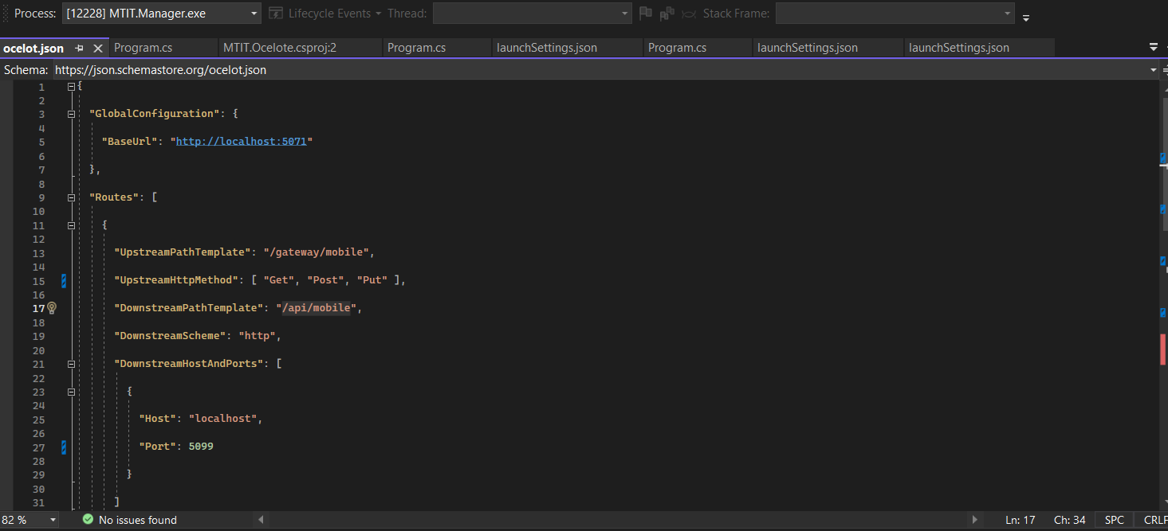
Supplier Service
Elaborate how you can avoid having multiple ports with the gateway you implemented and Solution should have proper folder structure with minimum two microservices and an Ocelot API Gateway.
Ocelot.json in Supplier Service

Slide 13
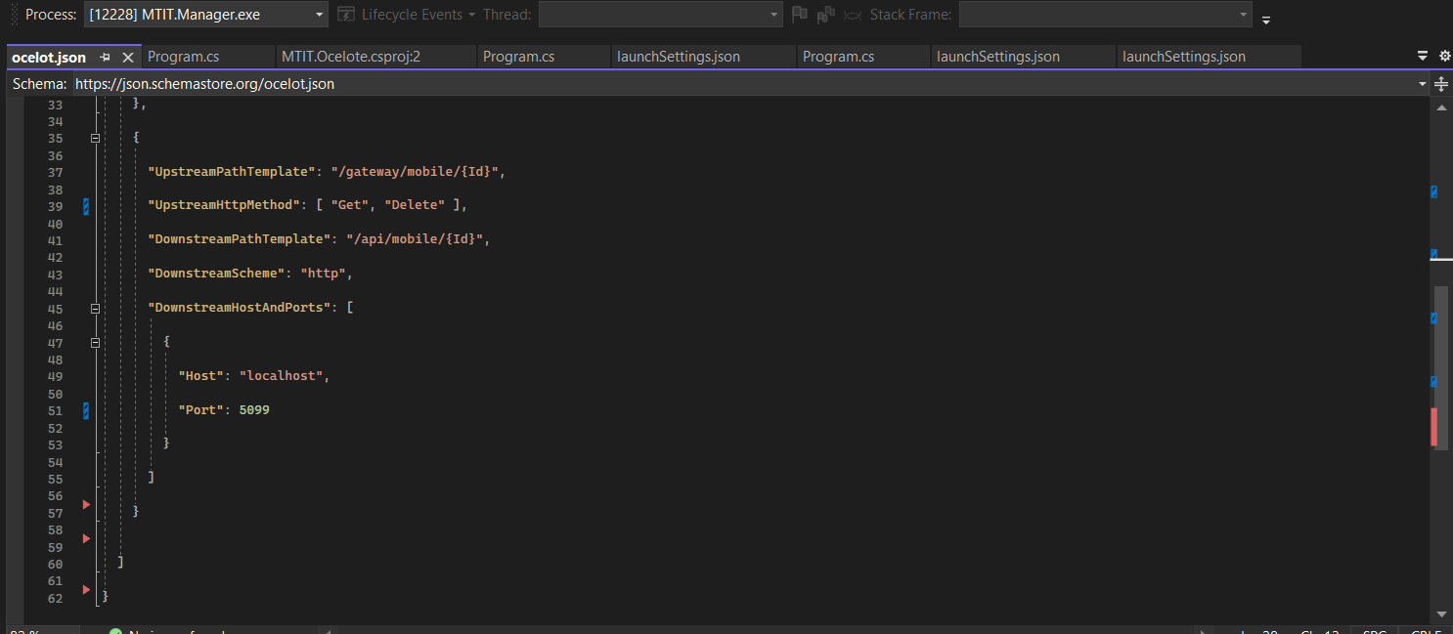
Ocelot.json in Supplier Service

Slide 14
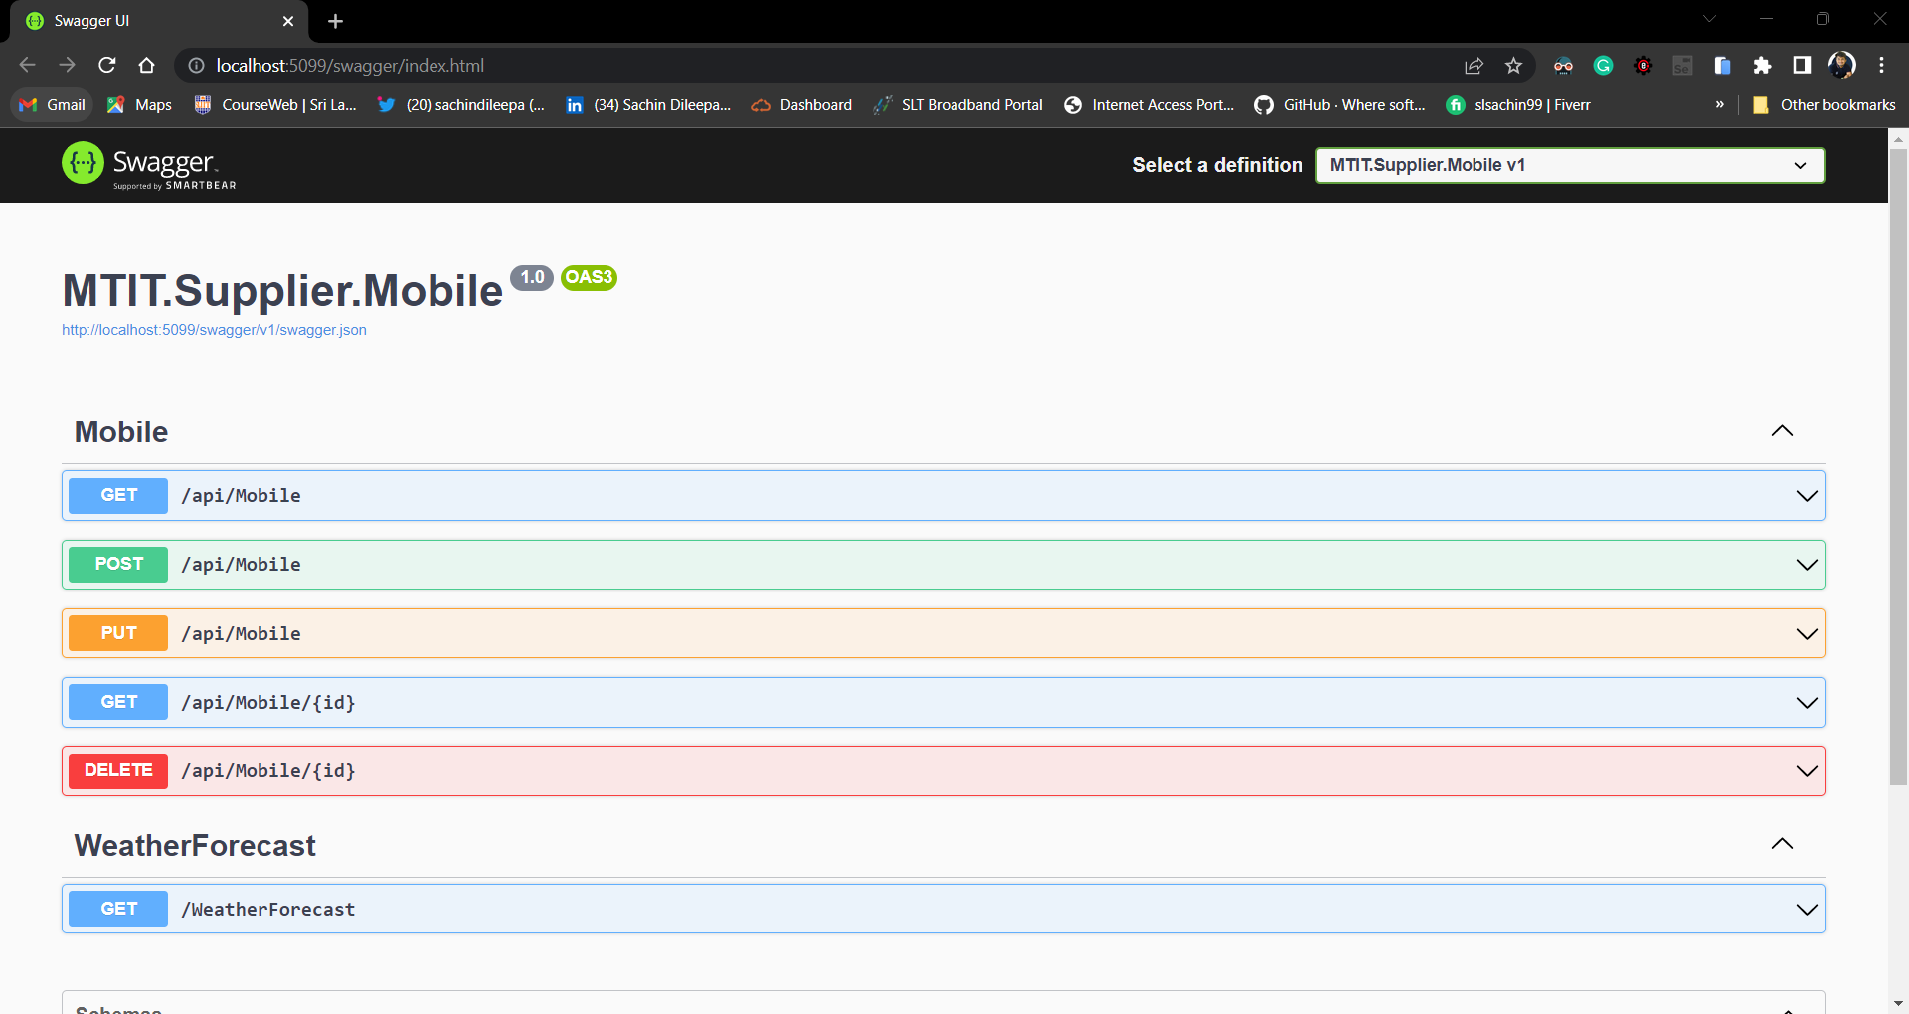
Screen captures OF Supplier API

Slide 15
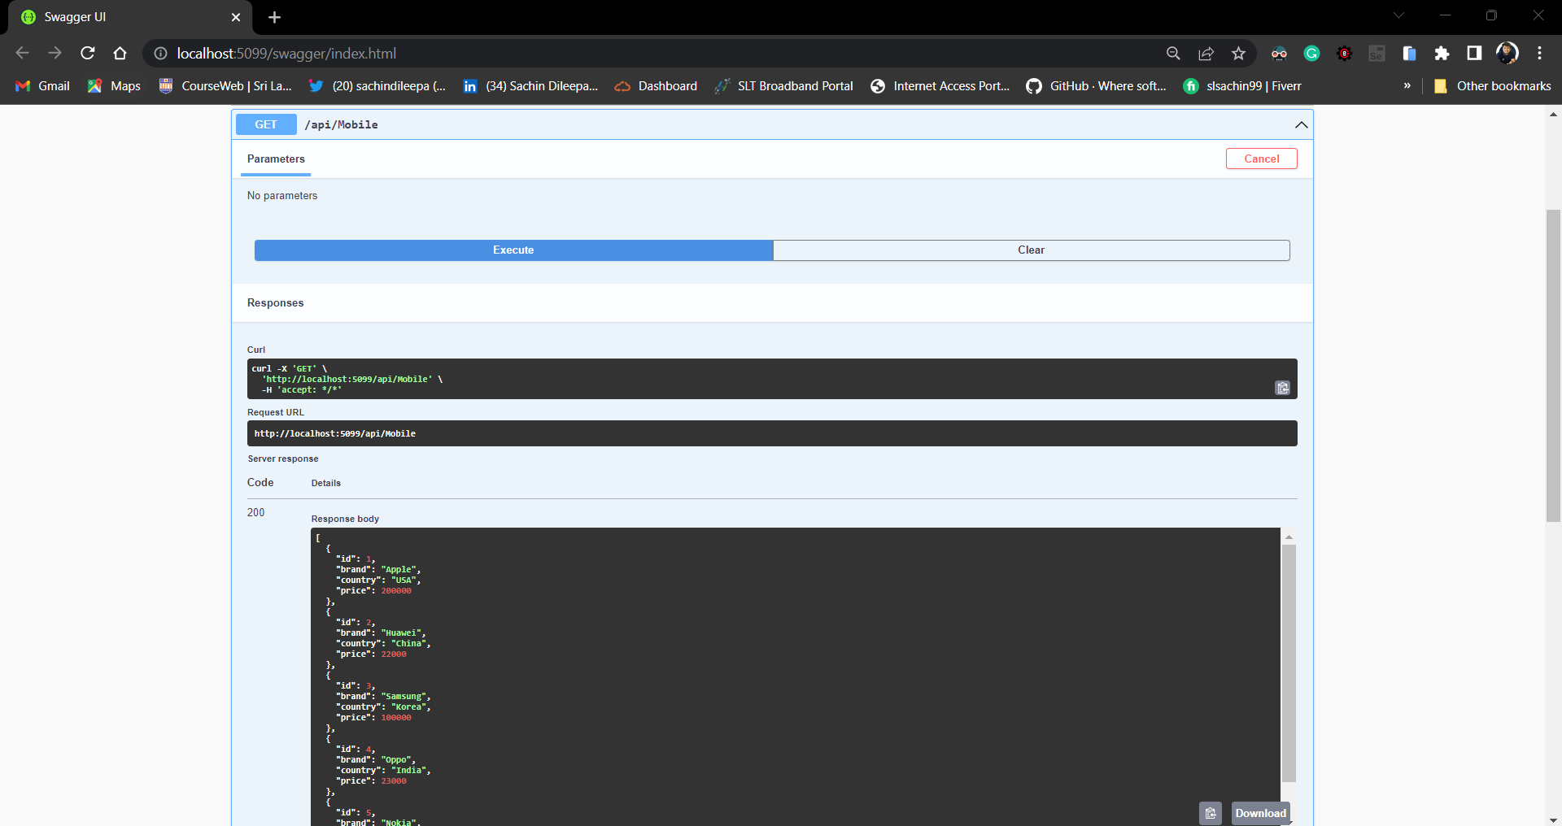
GET Method

Slide 16
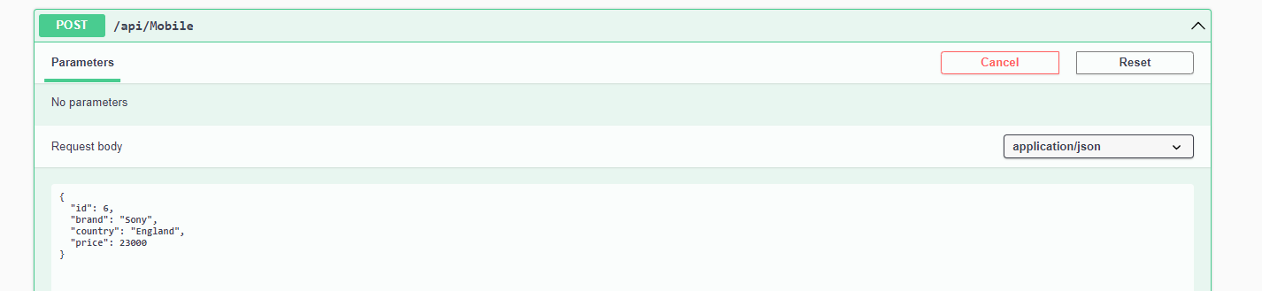
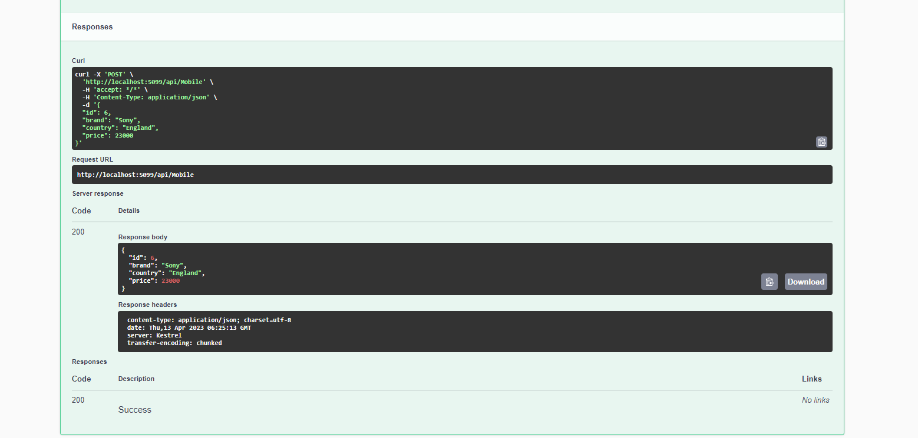
POST Method

Slide 17
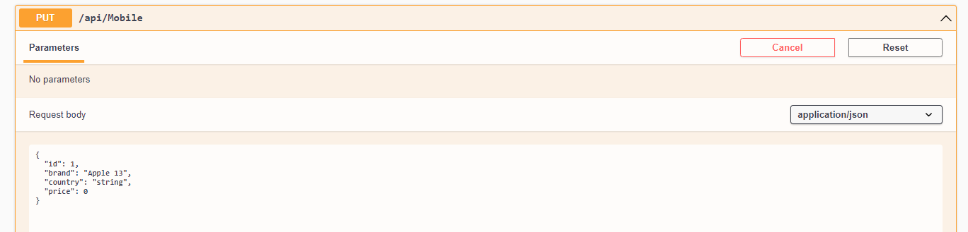
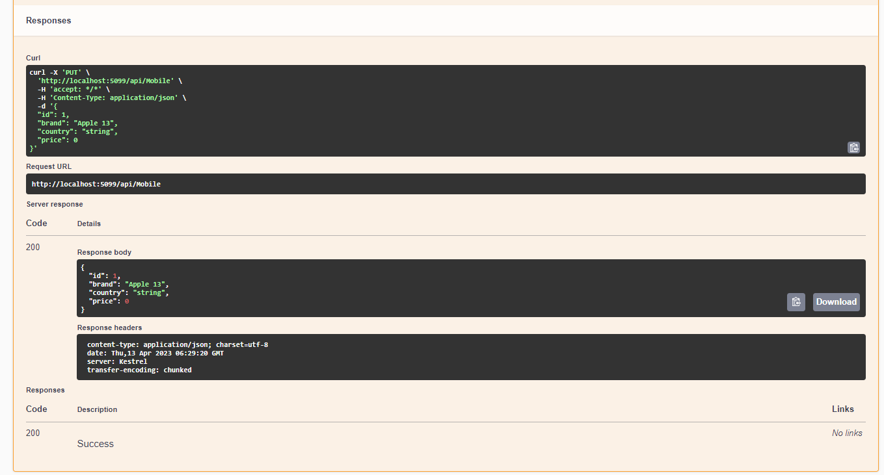
PUT Method

Slide 18
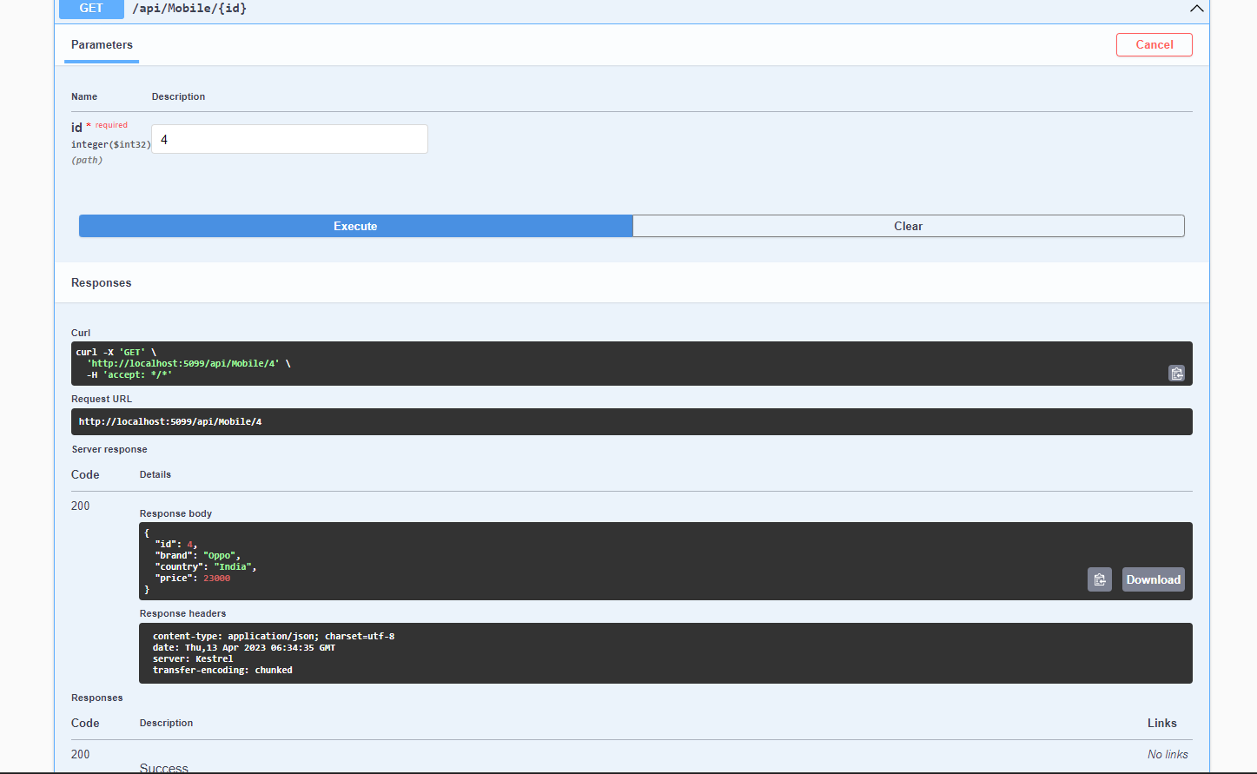
SEARCH

Slide 19
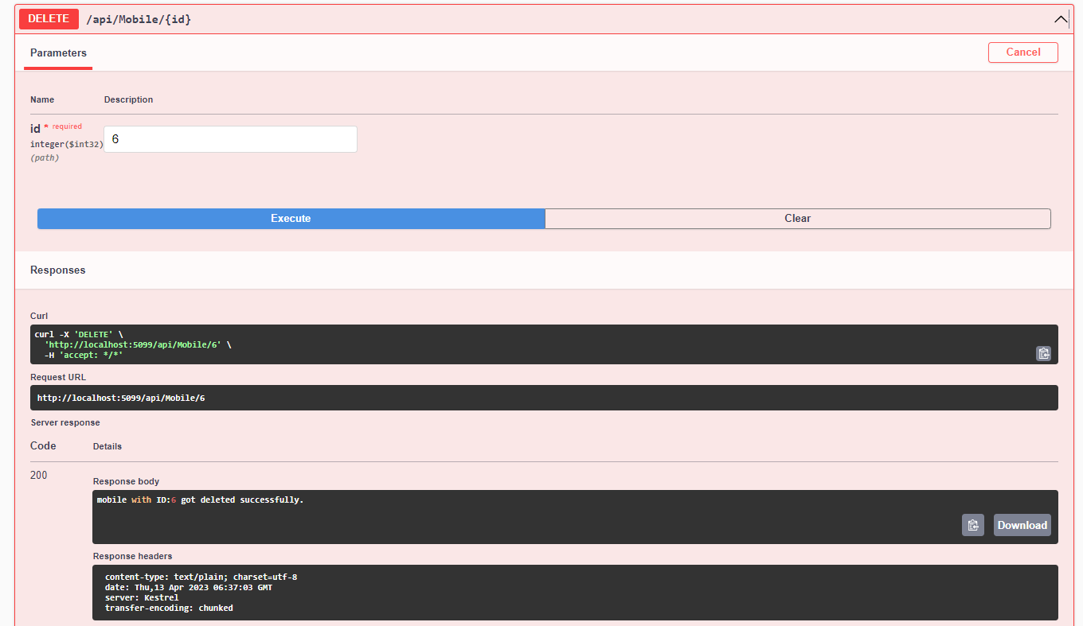
DELETE Method

Slide 20
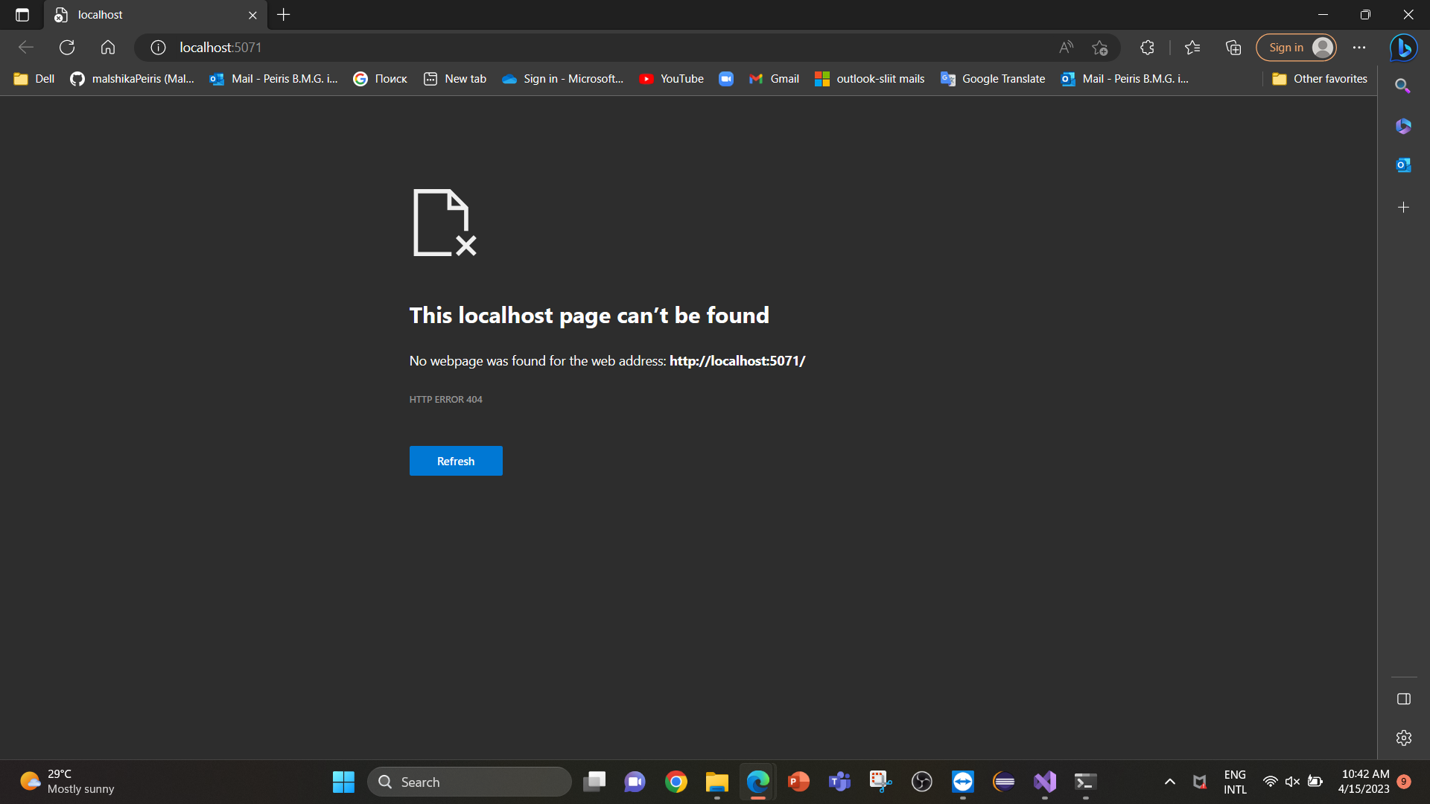
Gateway project and the API project will both run and open up in two separate browsers.
Gateway:

Slide 21
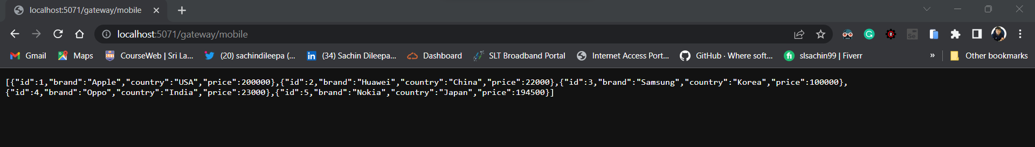
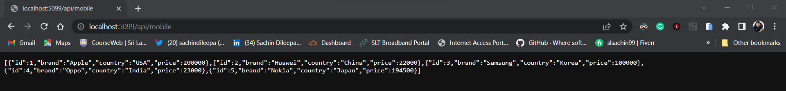
Test the upstream URL in browser.
Test the downstream URL in browser.

Slide 22
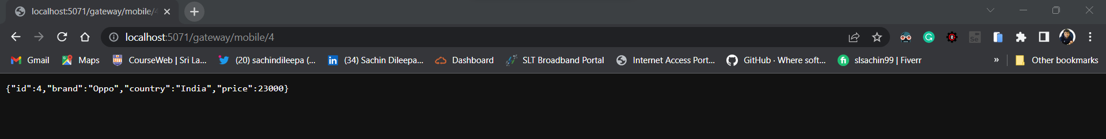
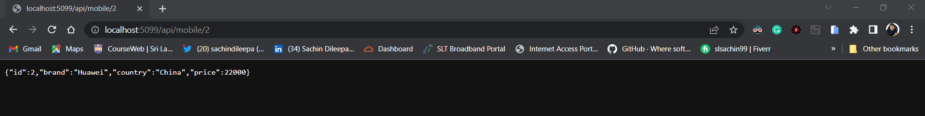
Test the upstream URL in browser.
Test the downstream URL in browser.

Slide 23
IT20147396
Peiris B M G
Manager Service

Slide 24
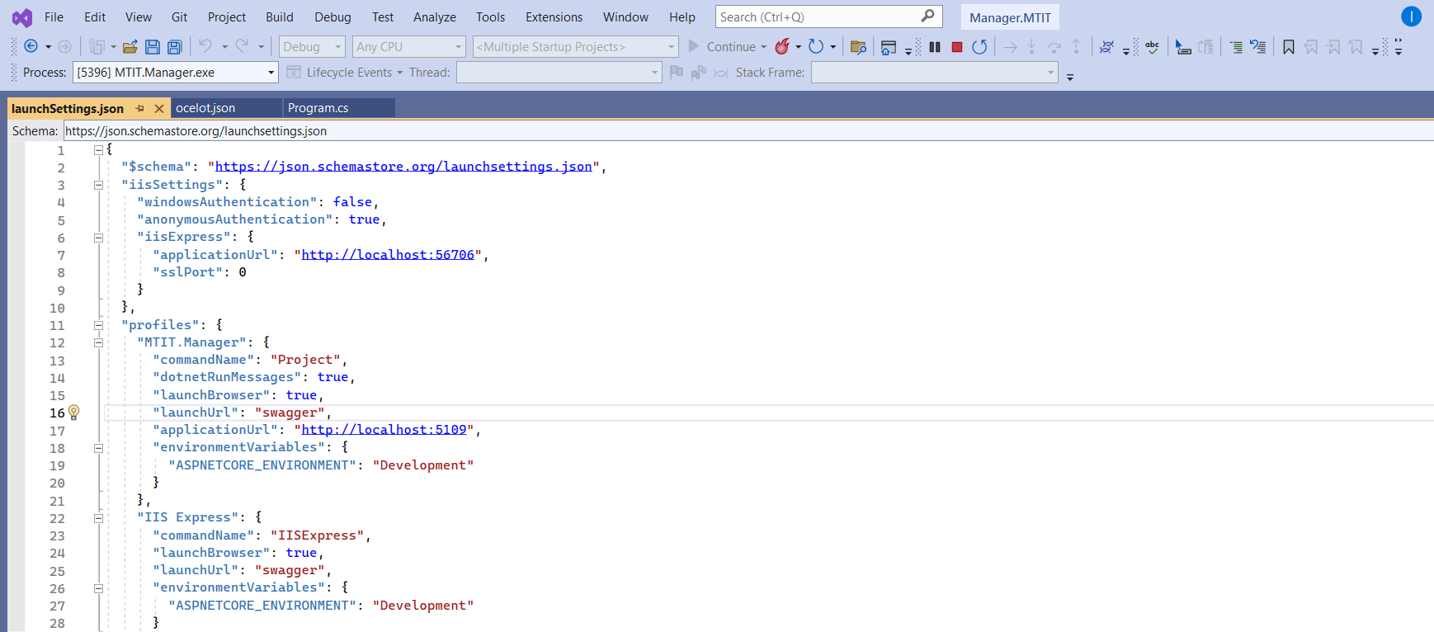
Manager Service
Elaborate how you can avoid having multiple ports with the gateway you implemented and Solution should have proper folder structure with minimum two microservices and an Ocelot API Gateway.
launchsettings.json in Manager service

Slide 25
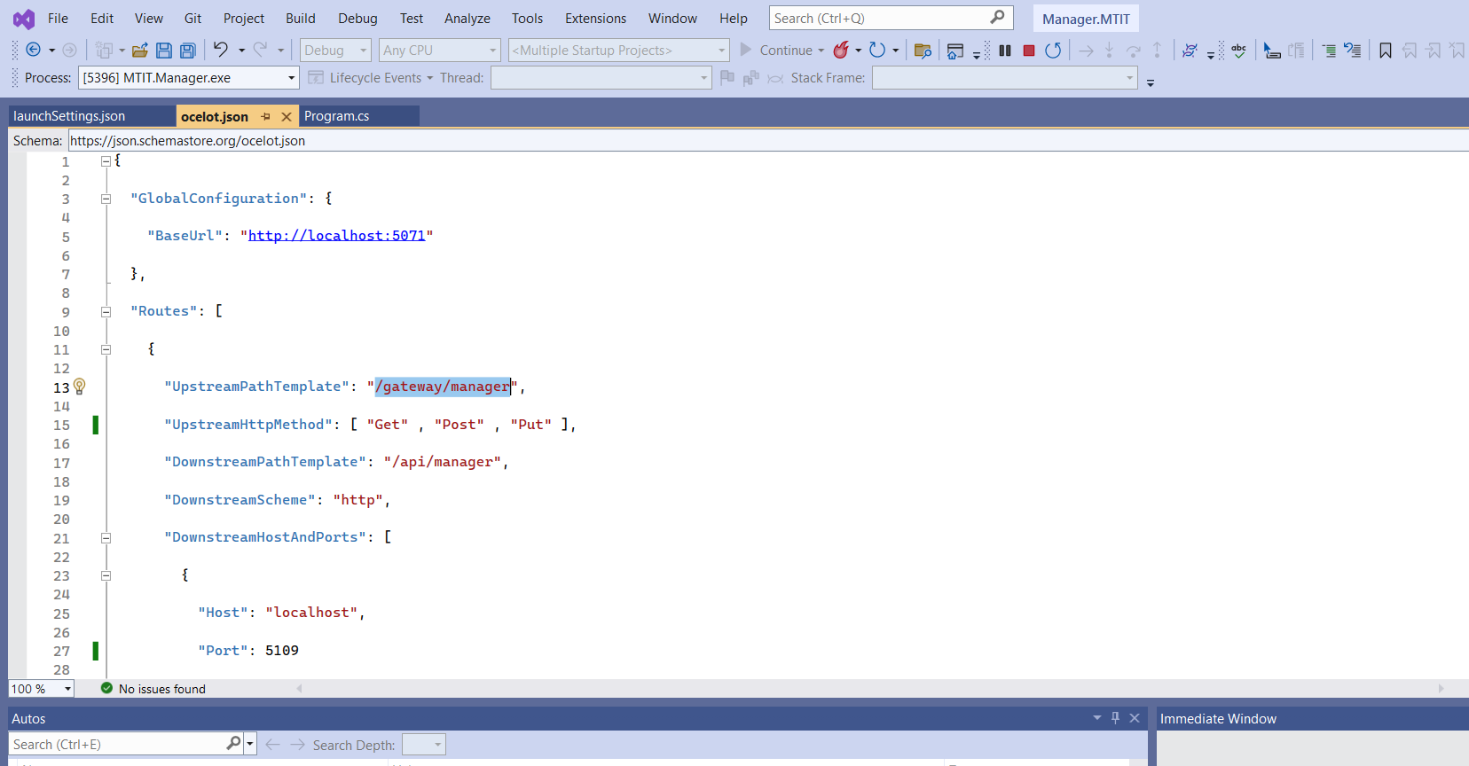
Ocelot.json in Manager service

Slide 26
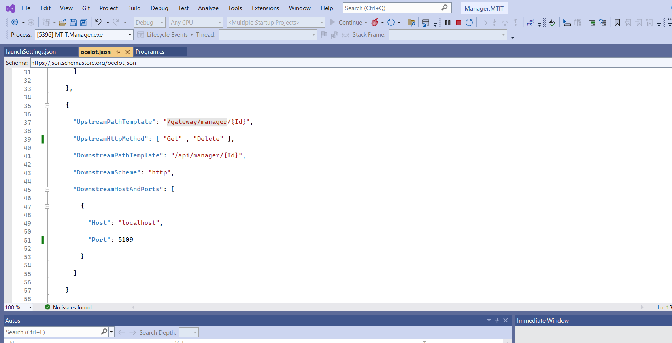
Ocelot.json in Manager service

Slide 27
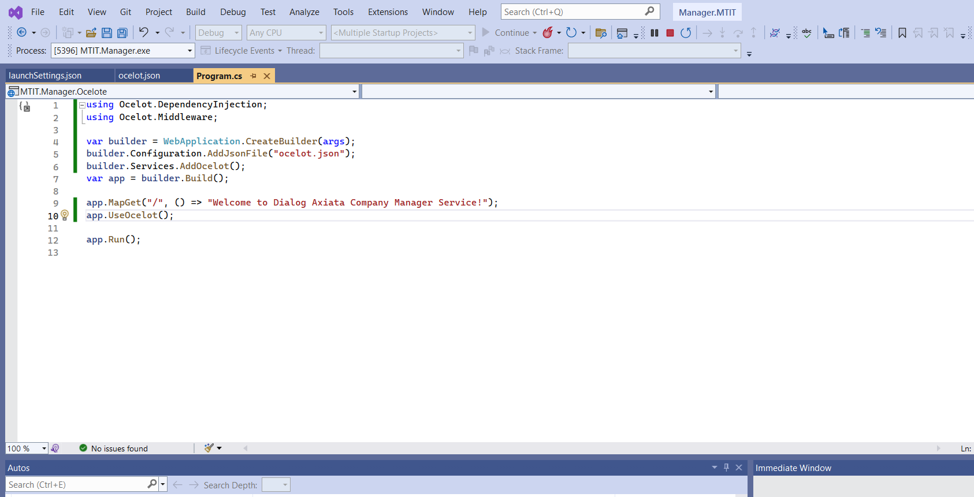
Program.cs in Manager service

Slide 28
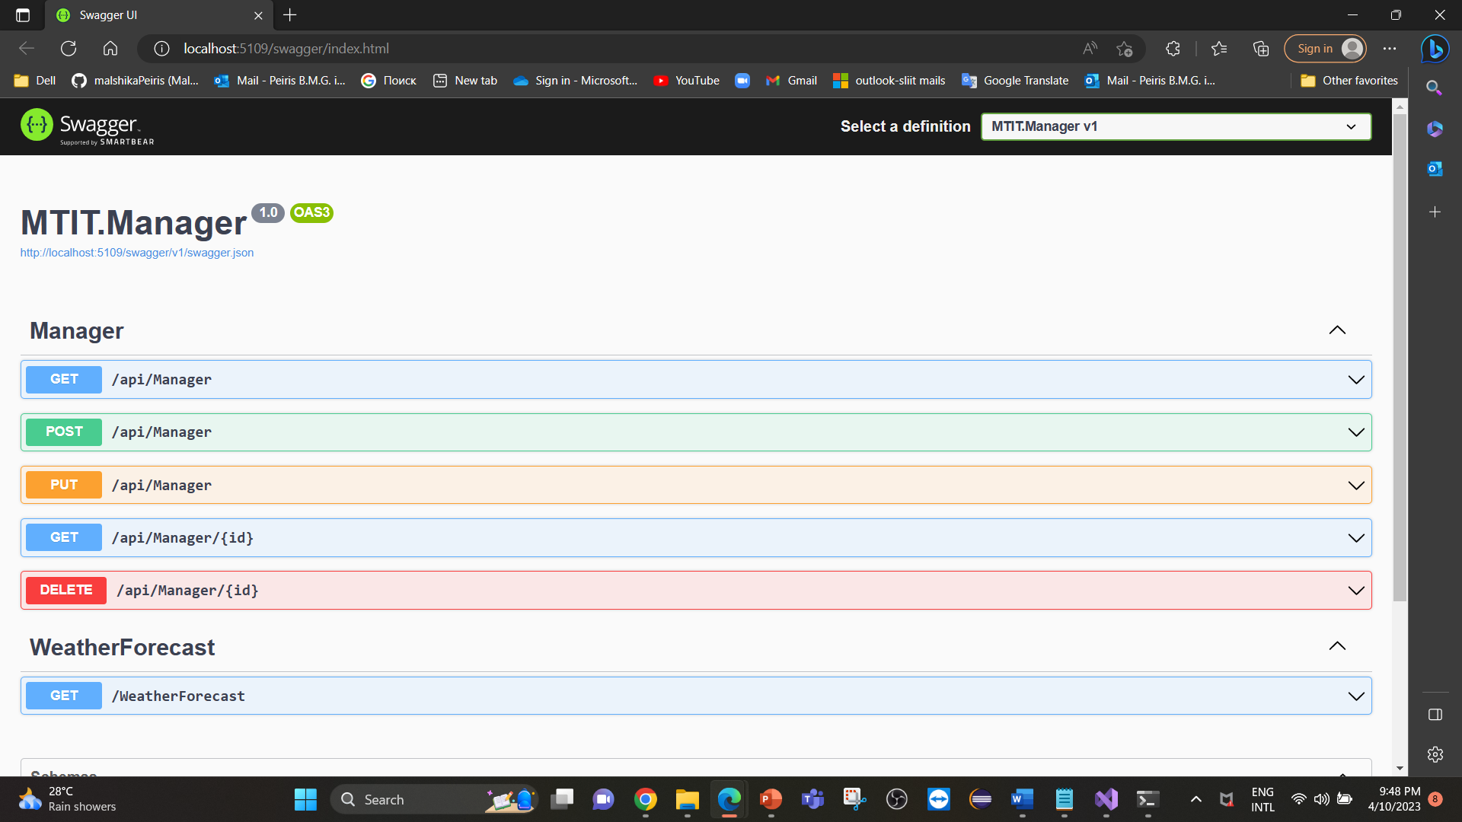
Screen captures OF Manager API

Slide 29
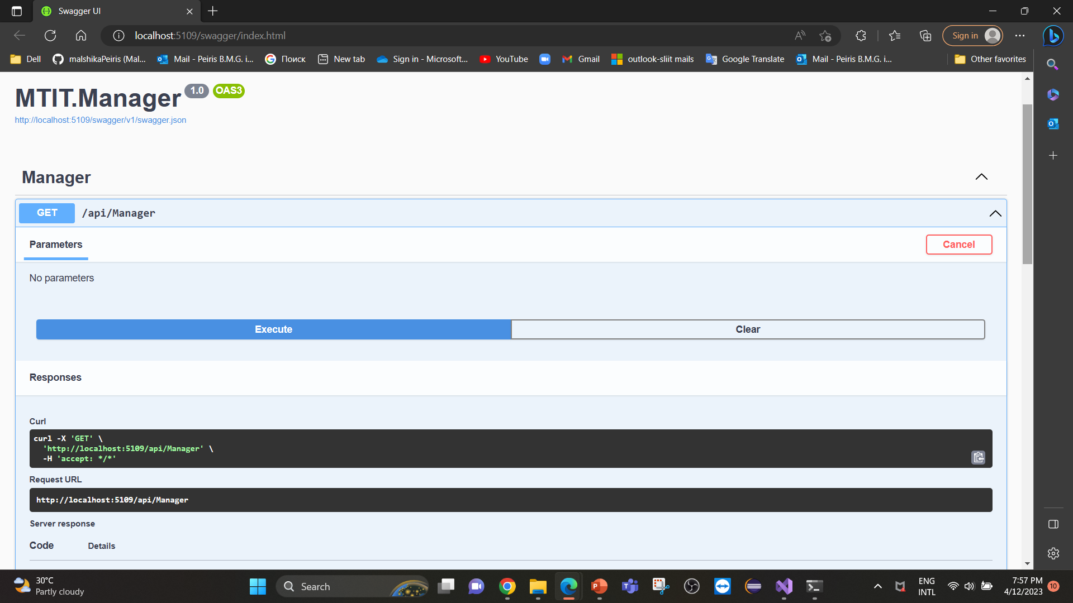
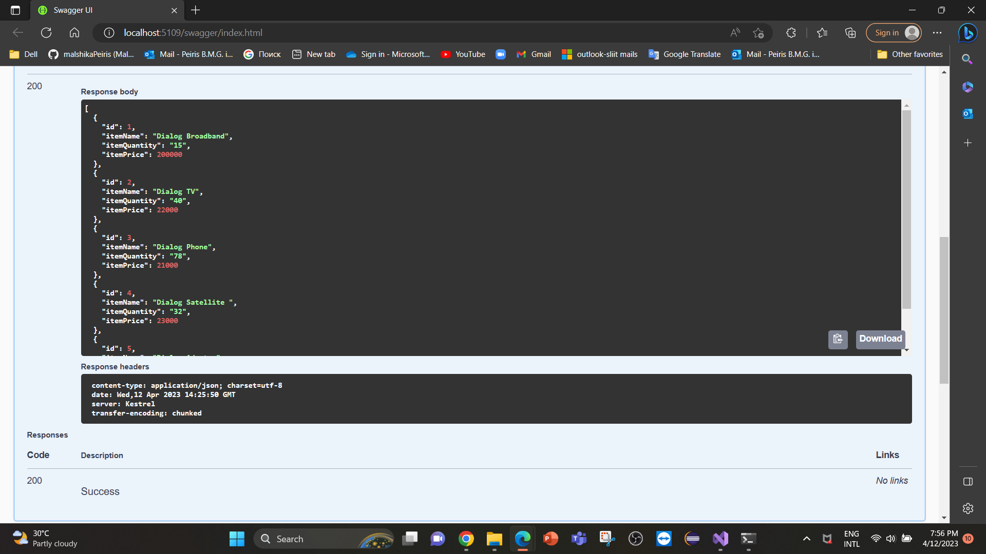
GET Method

Slide 30
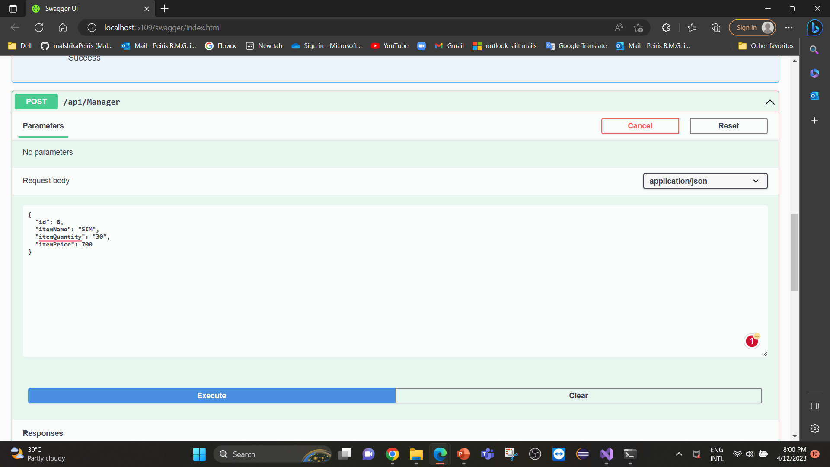
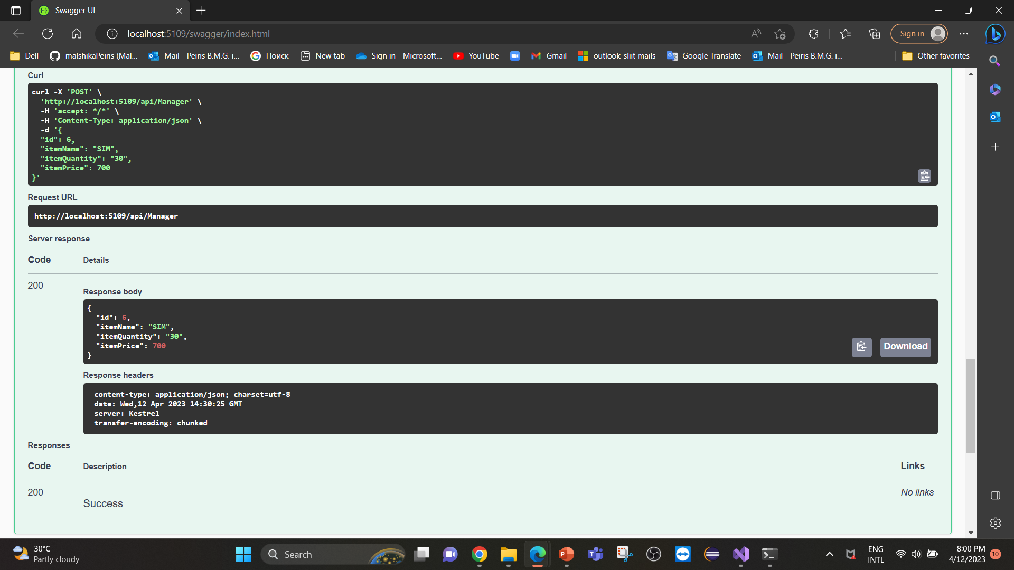
POST Method

Slide 31
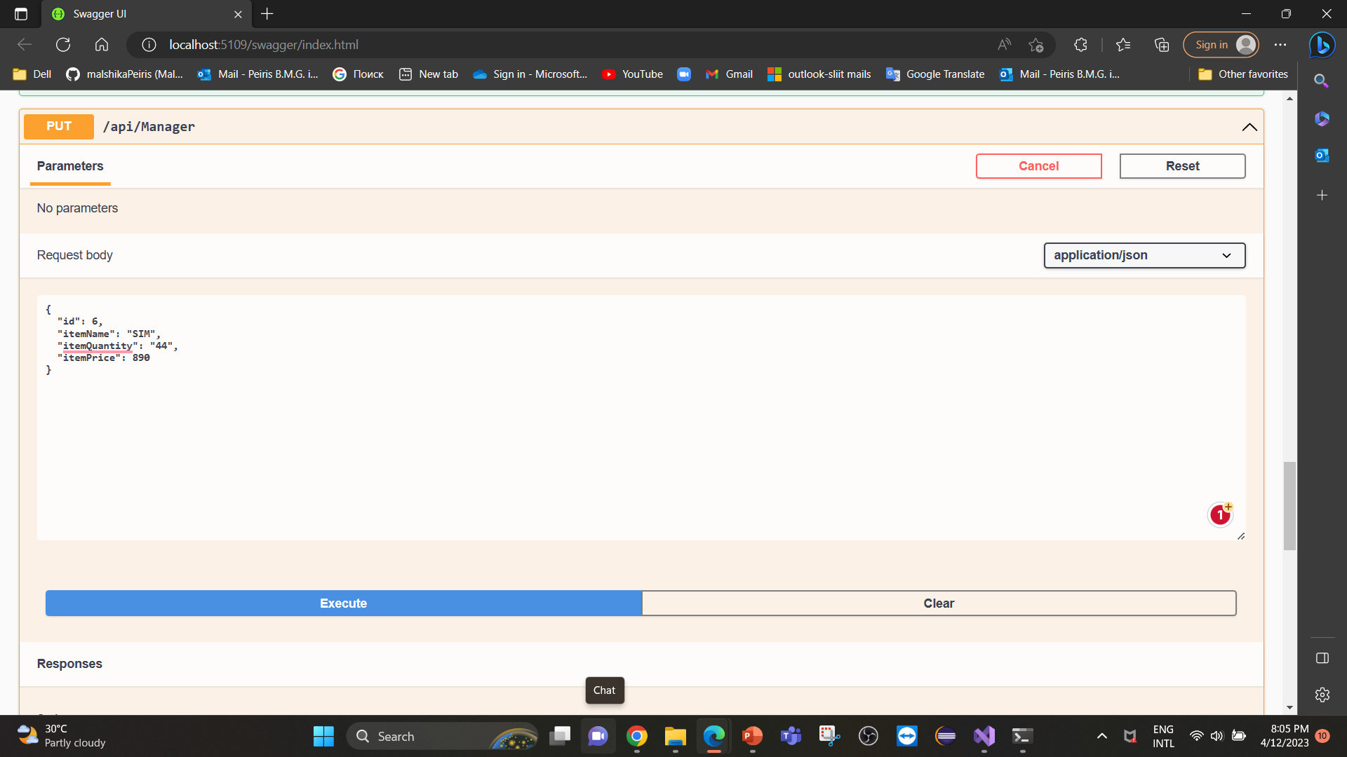
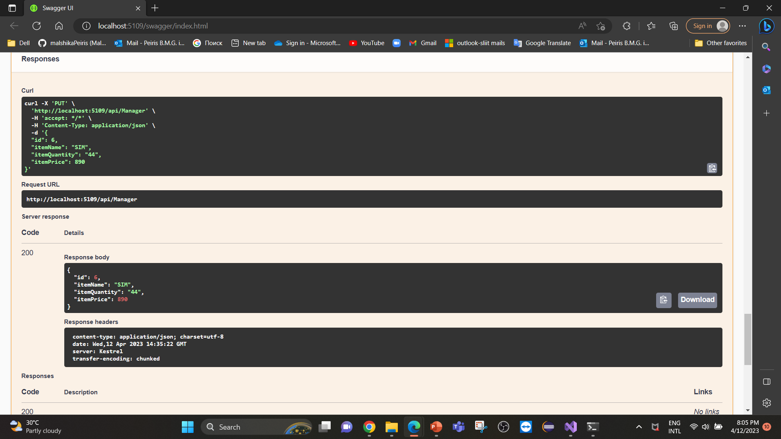
PUT Method

Slide 32
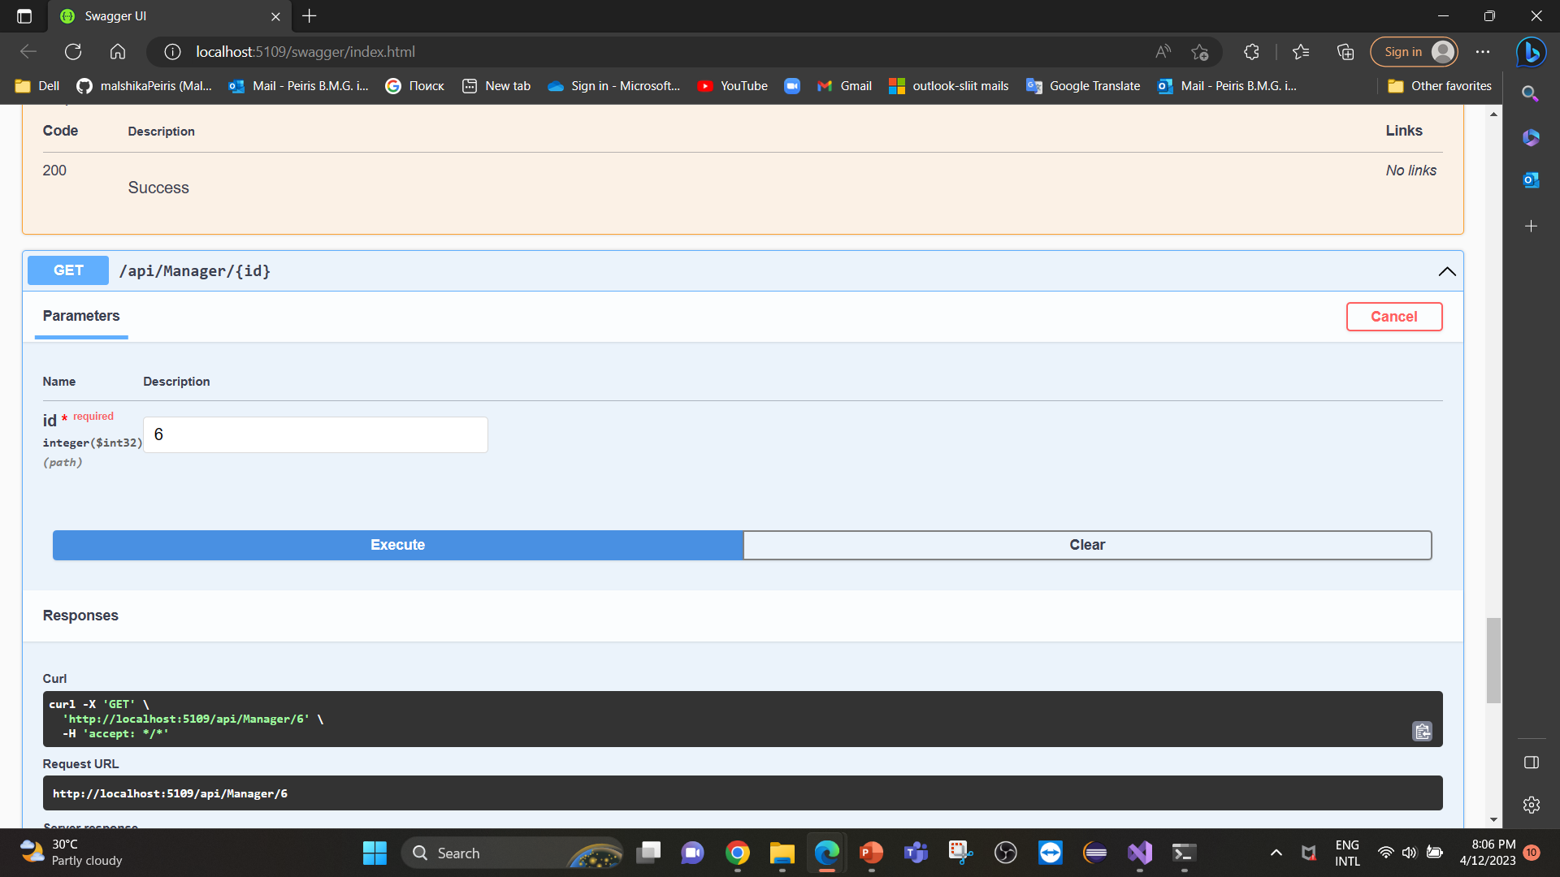
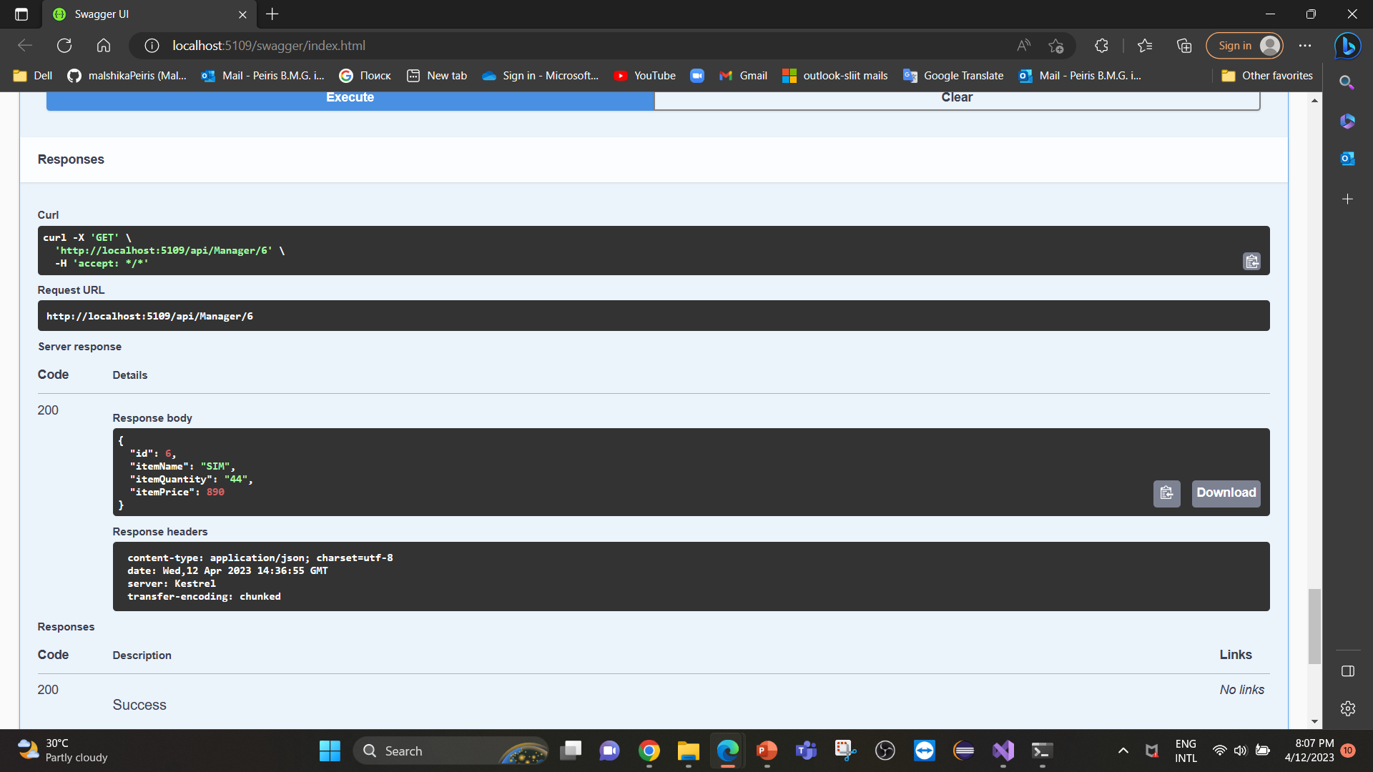
SEARCH

Slide 33
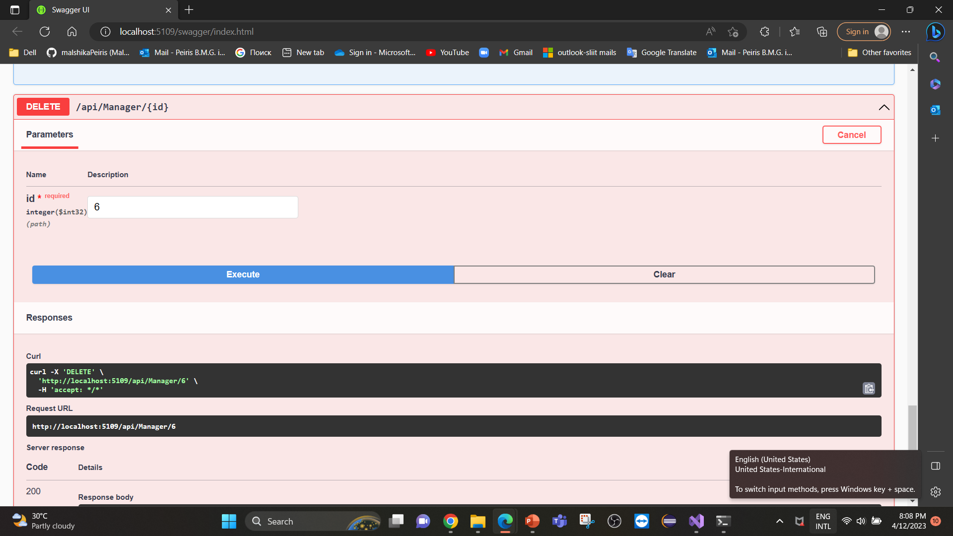
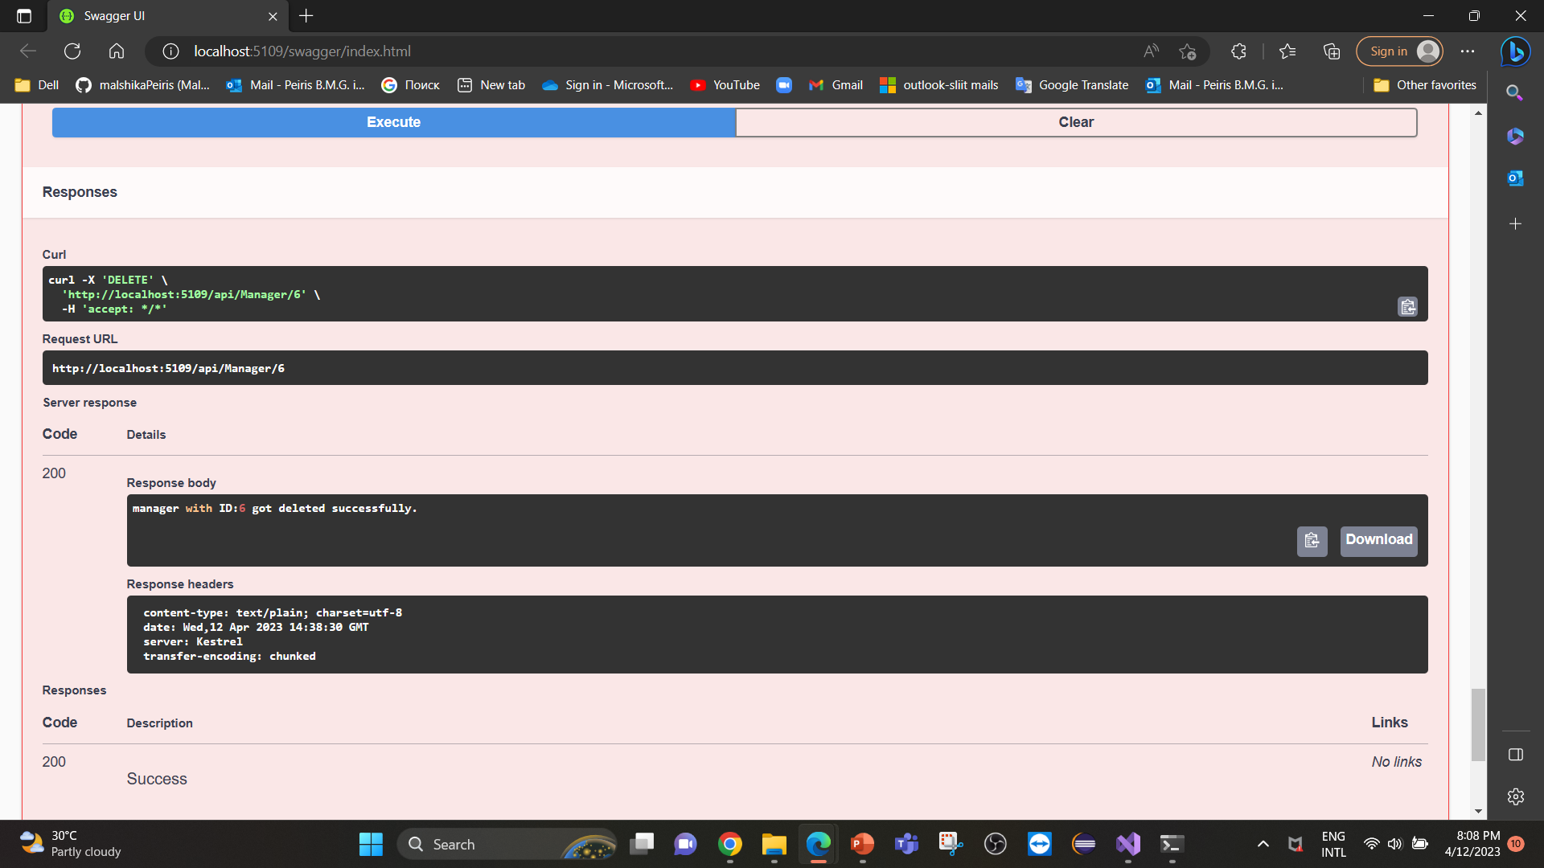
DELETE Method

Slide 34
Gateway project and the API project will both run and open up in two separate browsers.
Gateway:

Slide 35
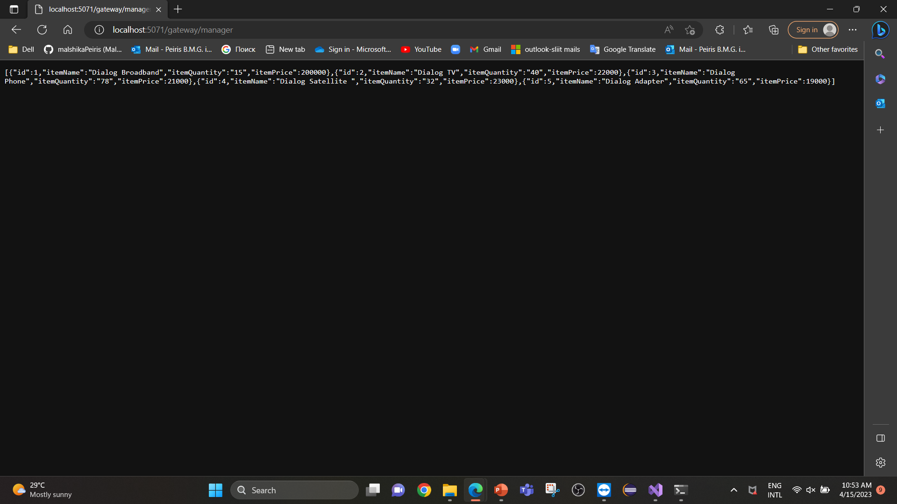
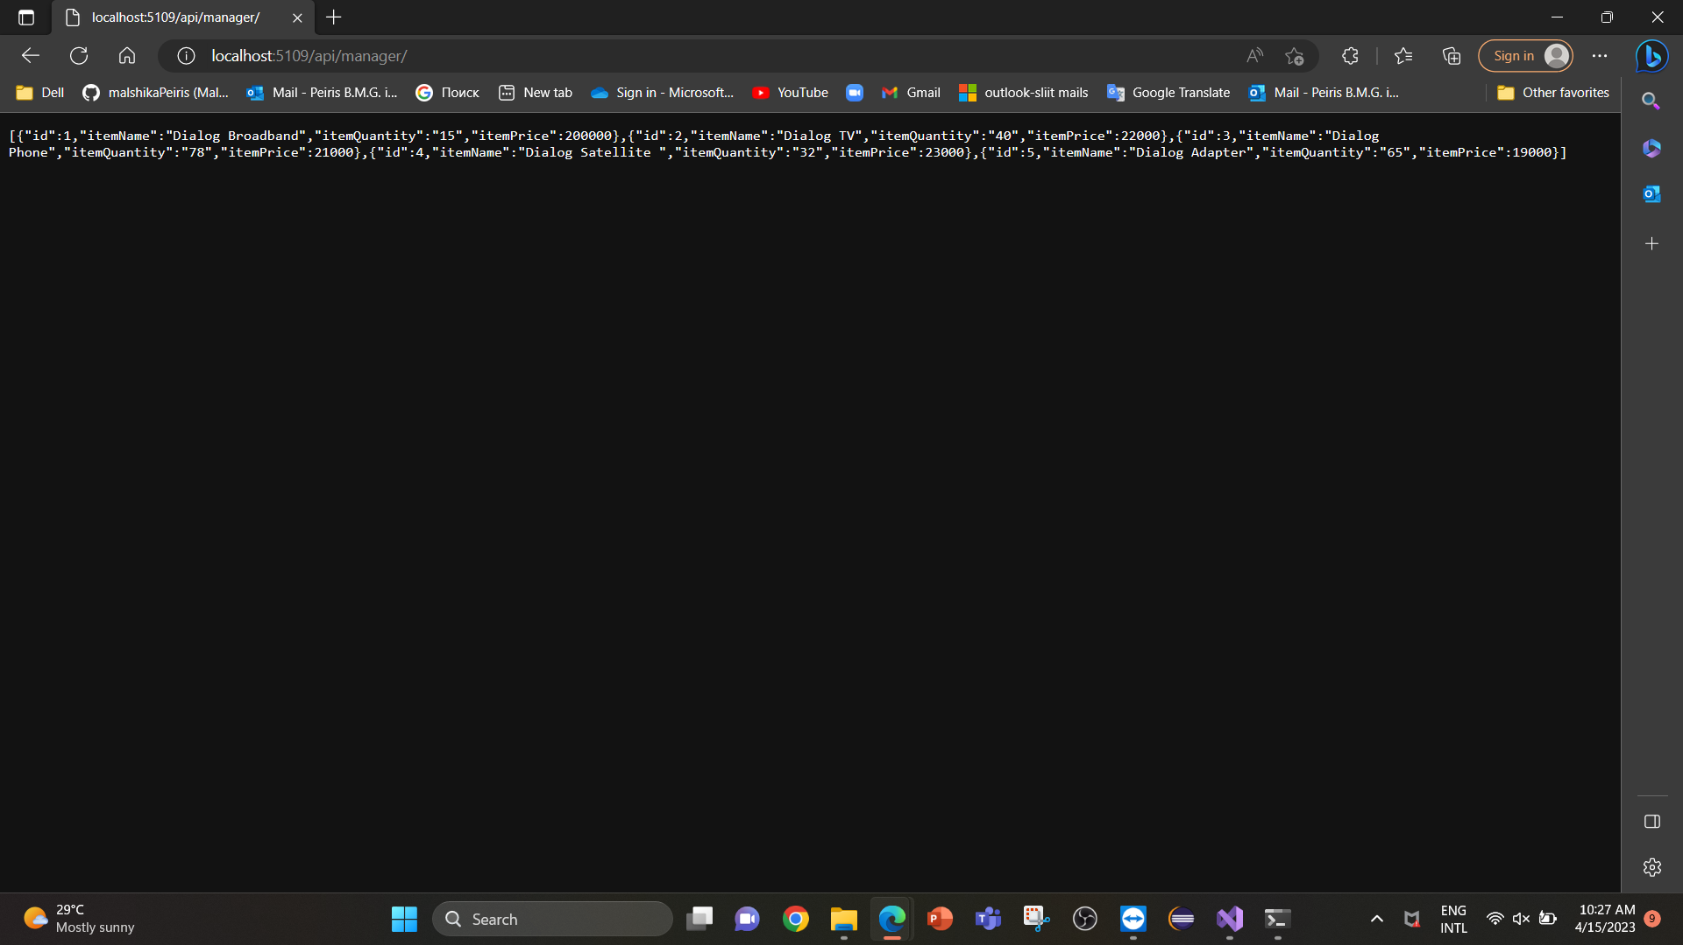
Test the upstream URL in browser.
Test the downstream URL in browser.

Slide 36
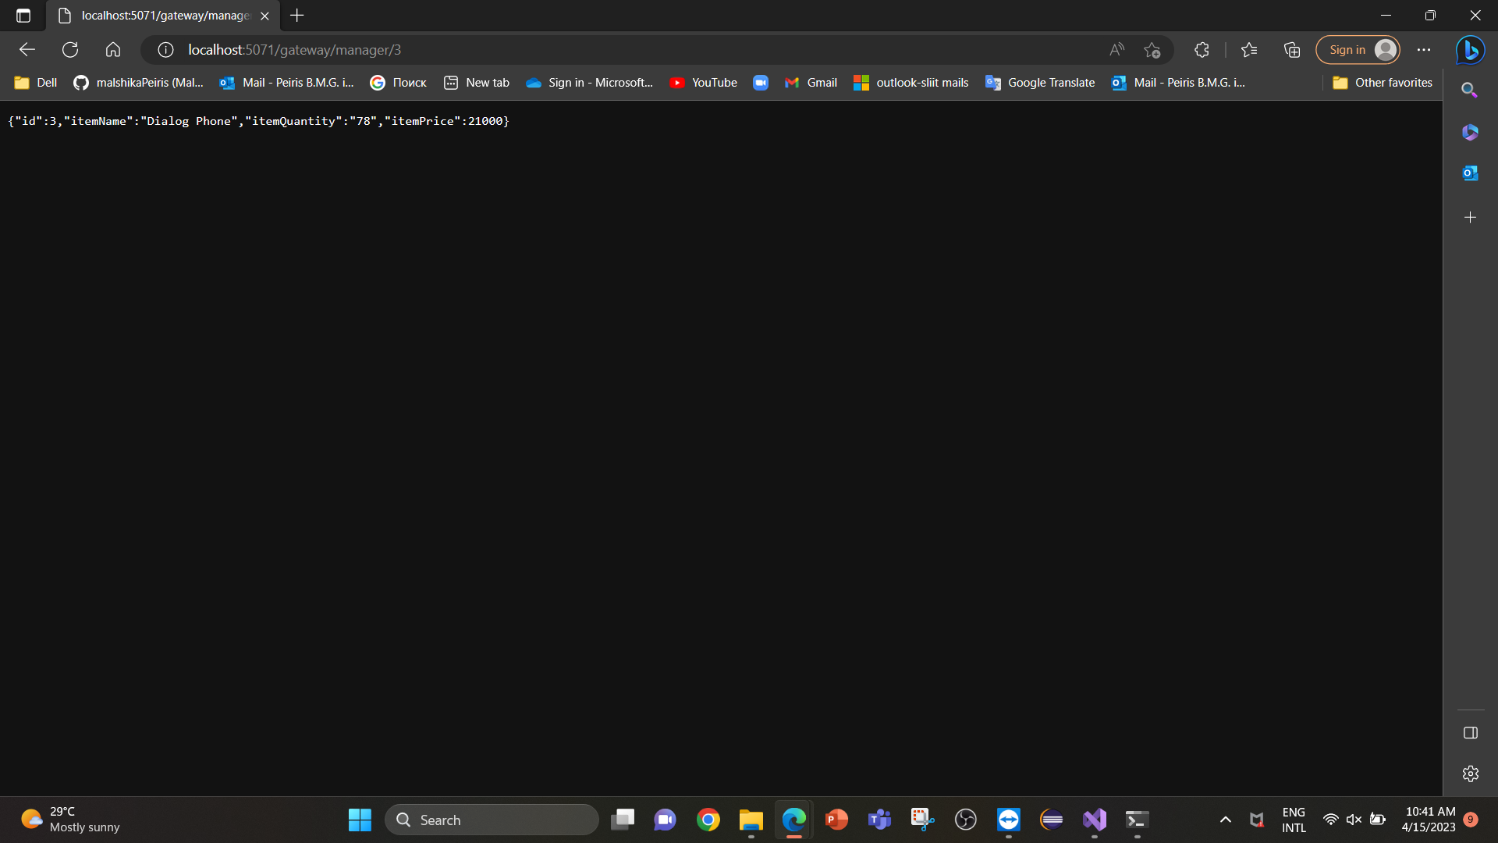

Test the upstream URL in browser.
Test the downstream URL in browser.

Slide 37
IT20122782
Amani M P N
Store Keeper Service

Slide 38
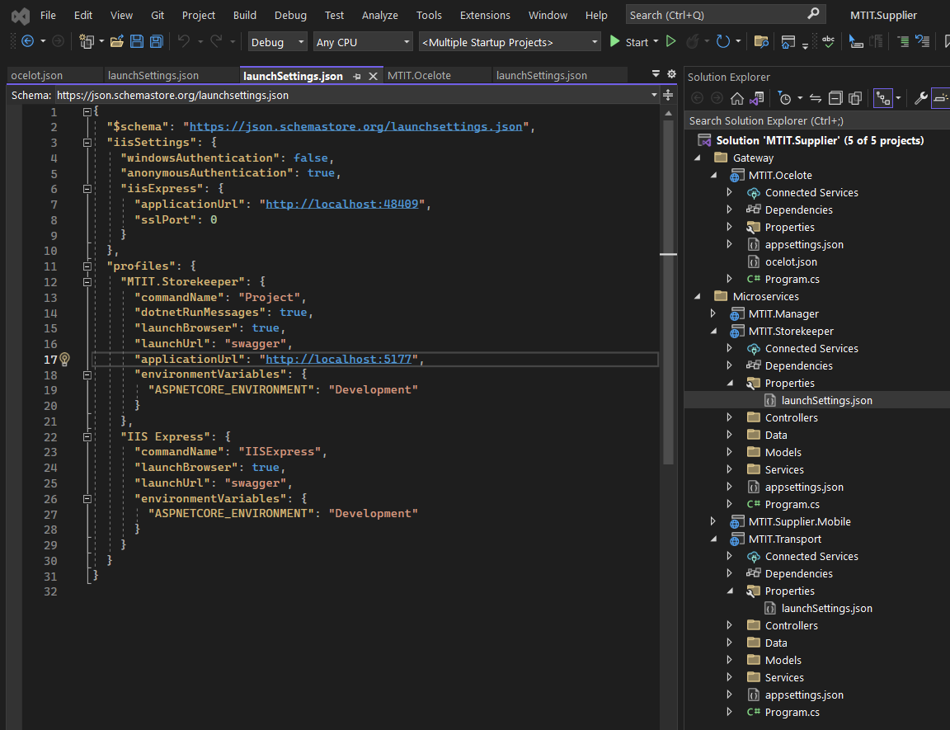
StoreKeeper Service
Elaborate how you can avoid having multiple ports with the gateway you implemented and Solution should have proper folder structure with minimum two microservices and an Ocelot API Gateway.
launchsettings.json in StoreKeeper service

Slide 39
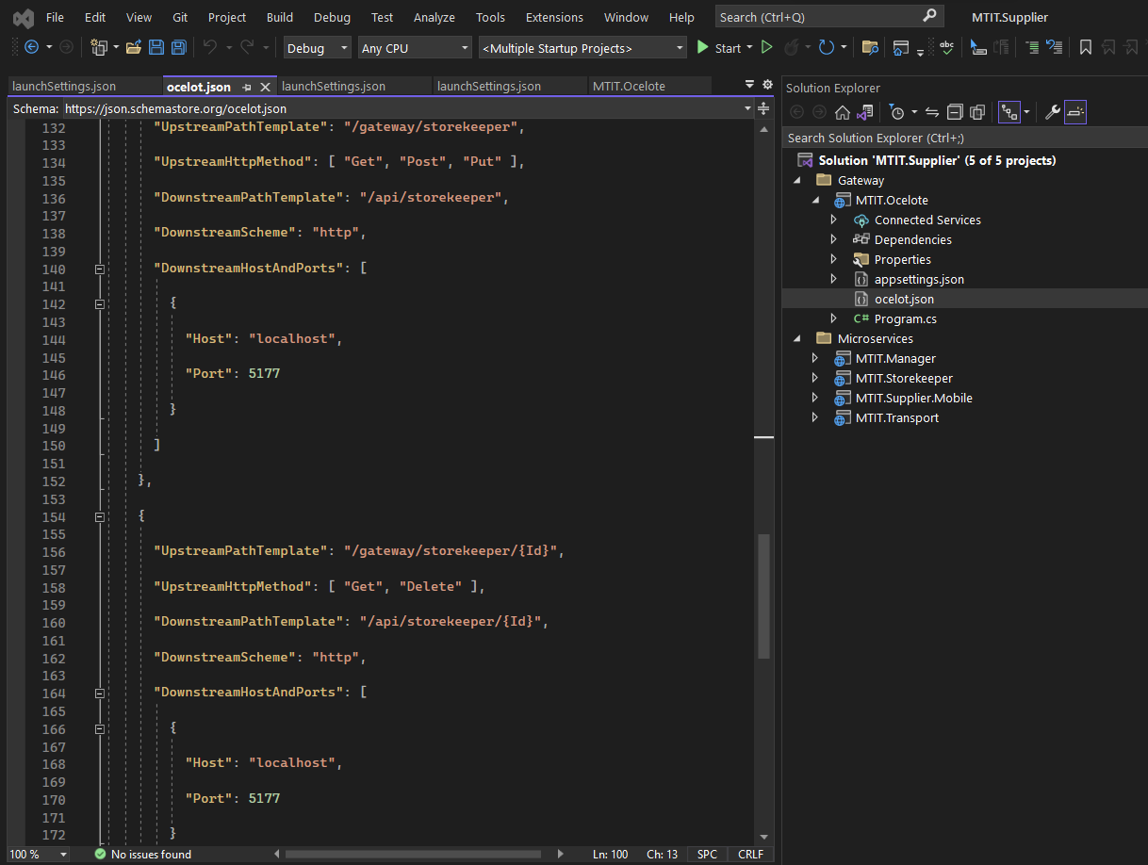
Ocelot.json in StoreKeeper service

Slide 40
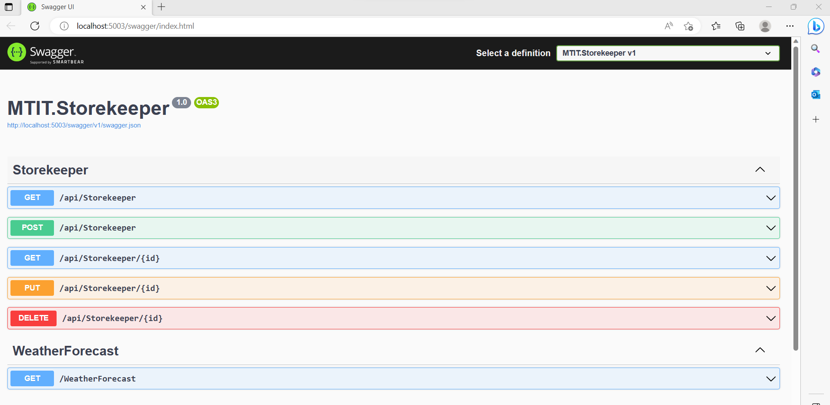
Screen captures OF Storekeeper API

Slide 41
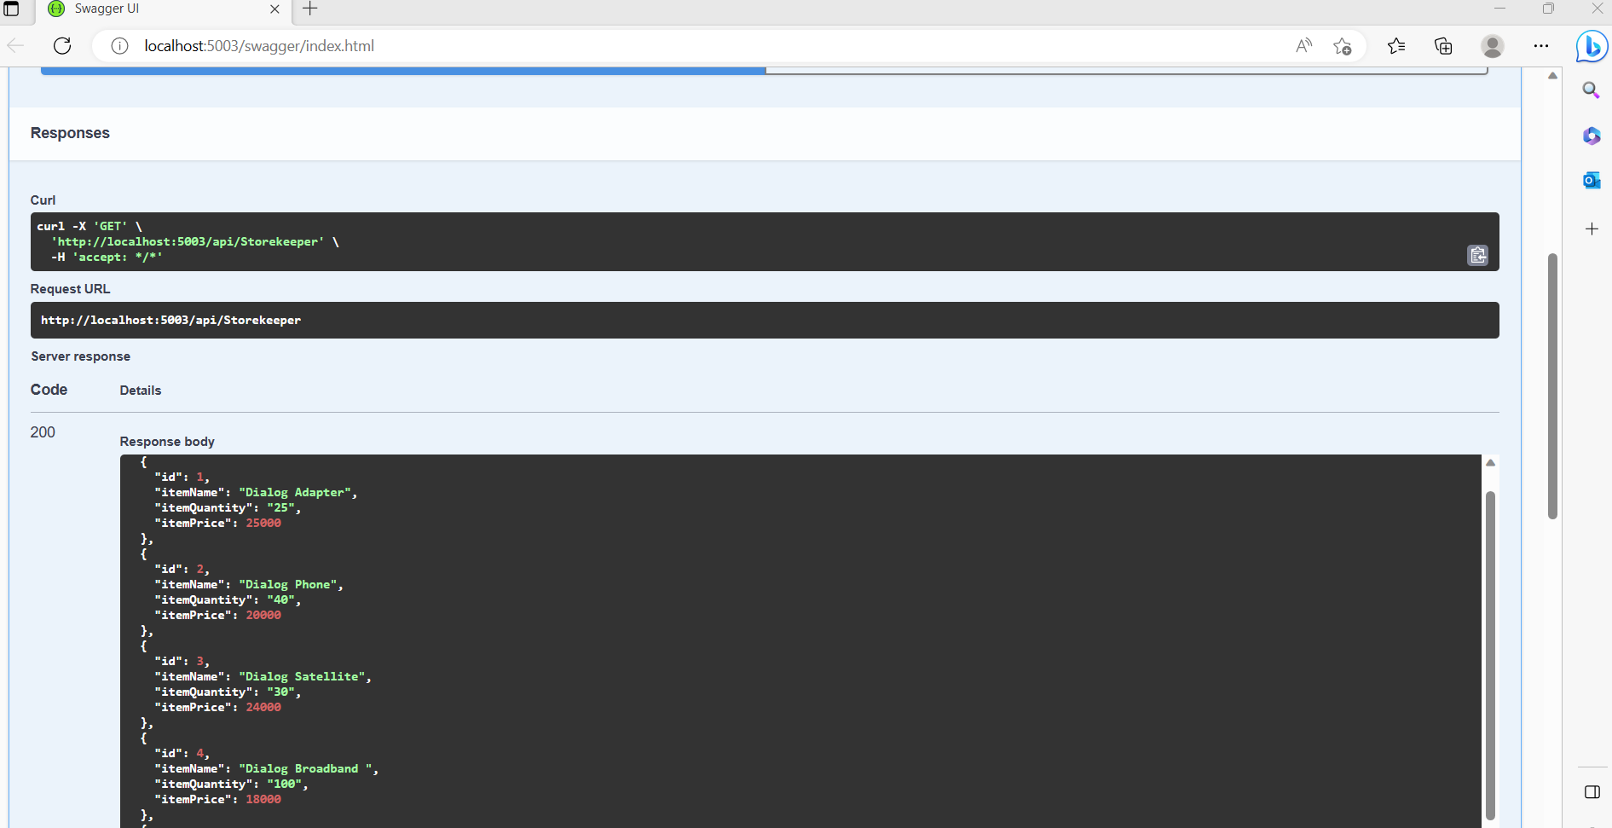
GET Method

Slide 42
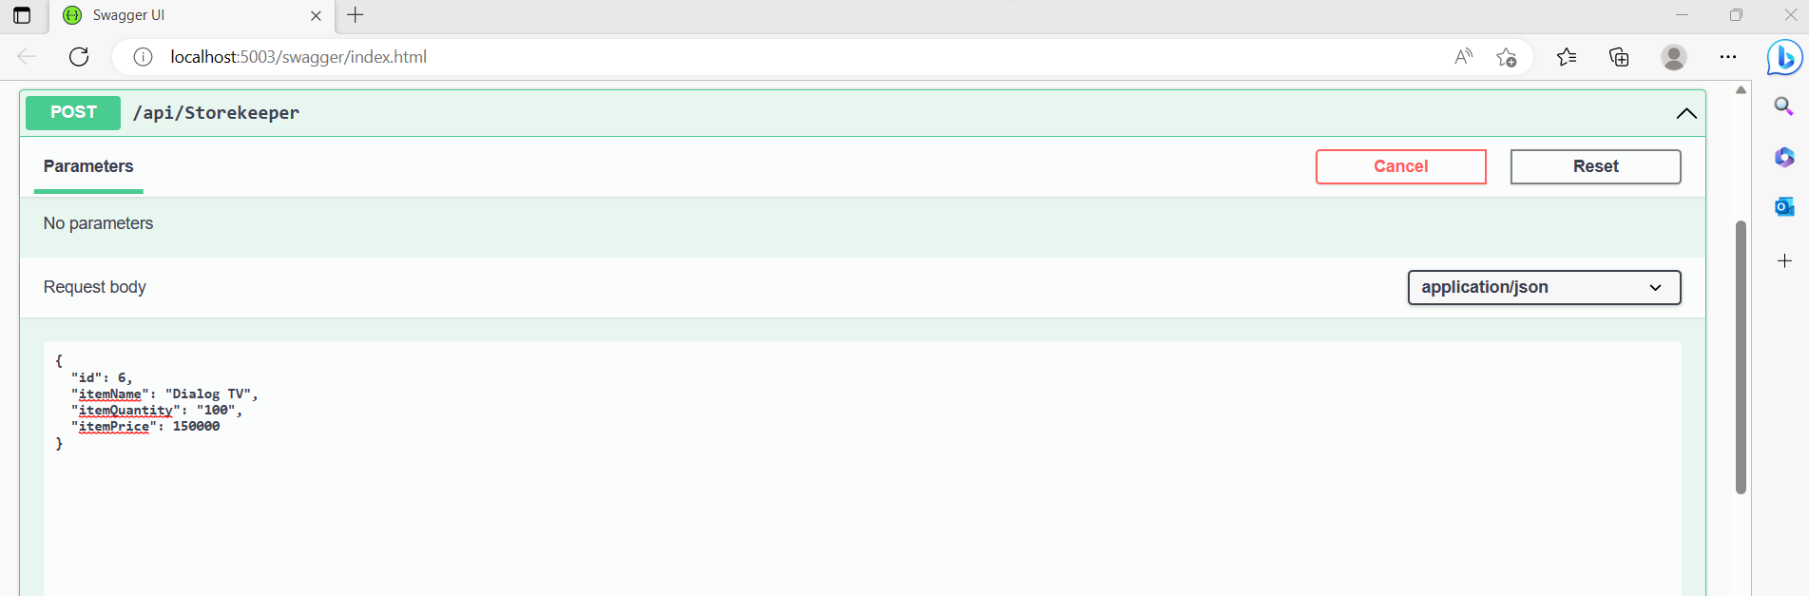
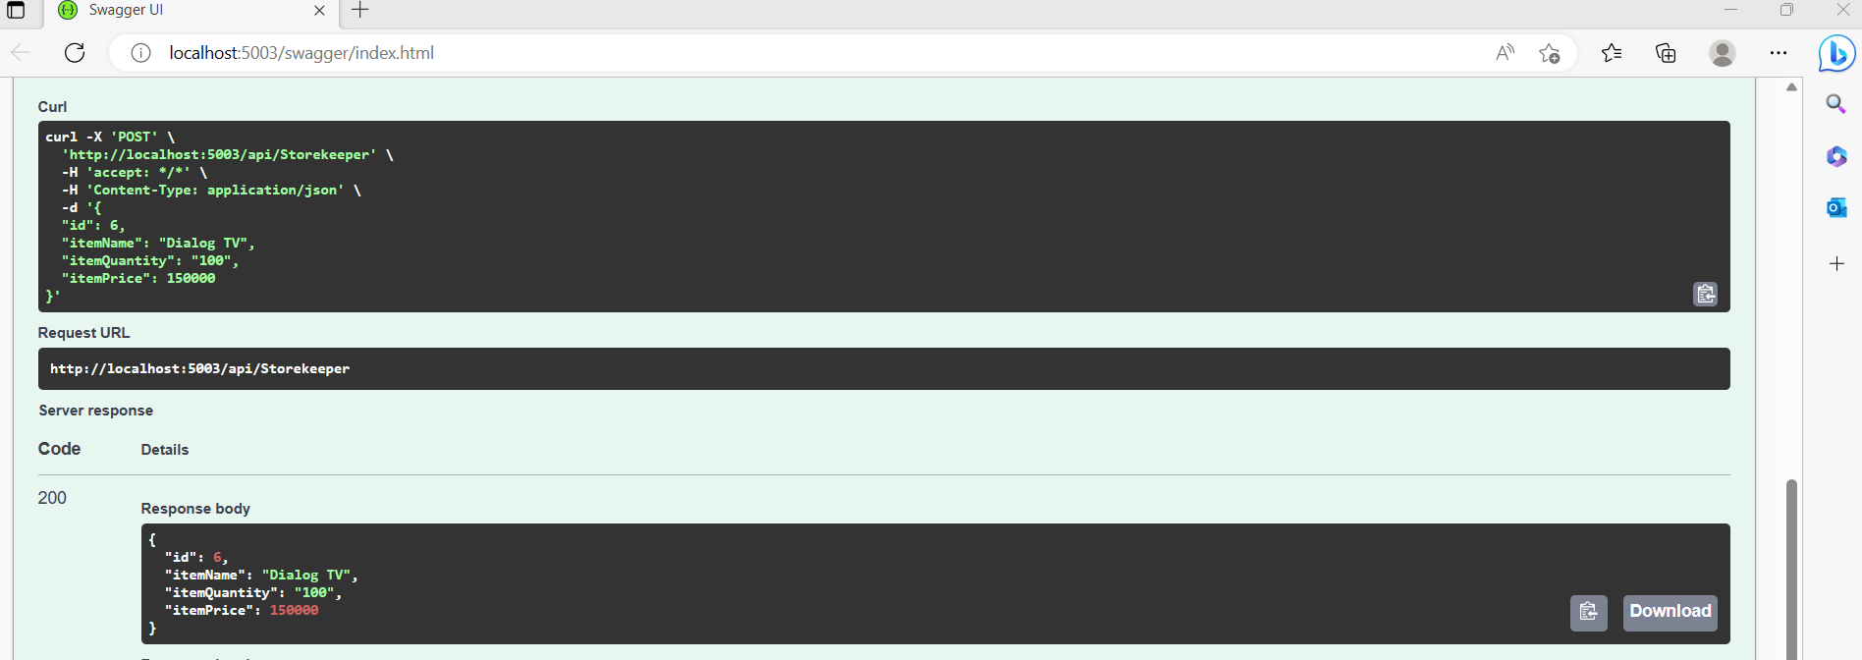
POST Method

Slide 43
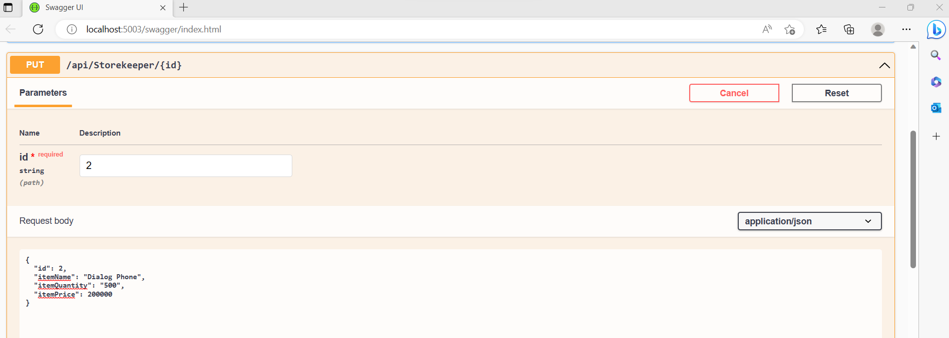
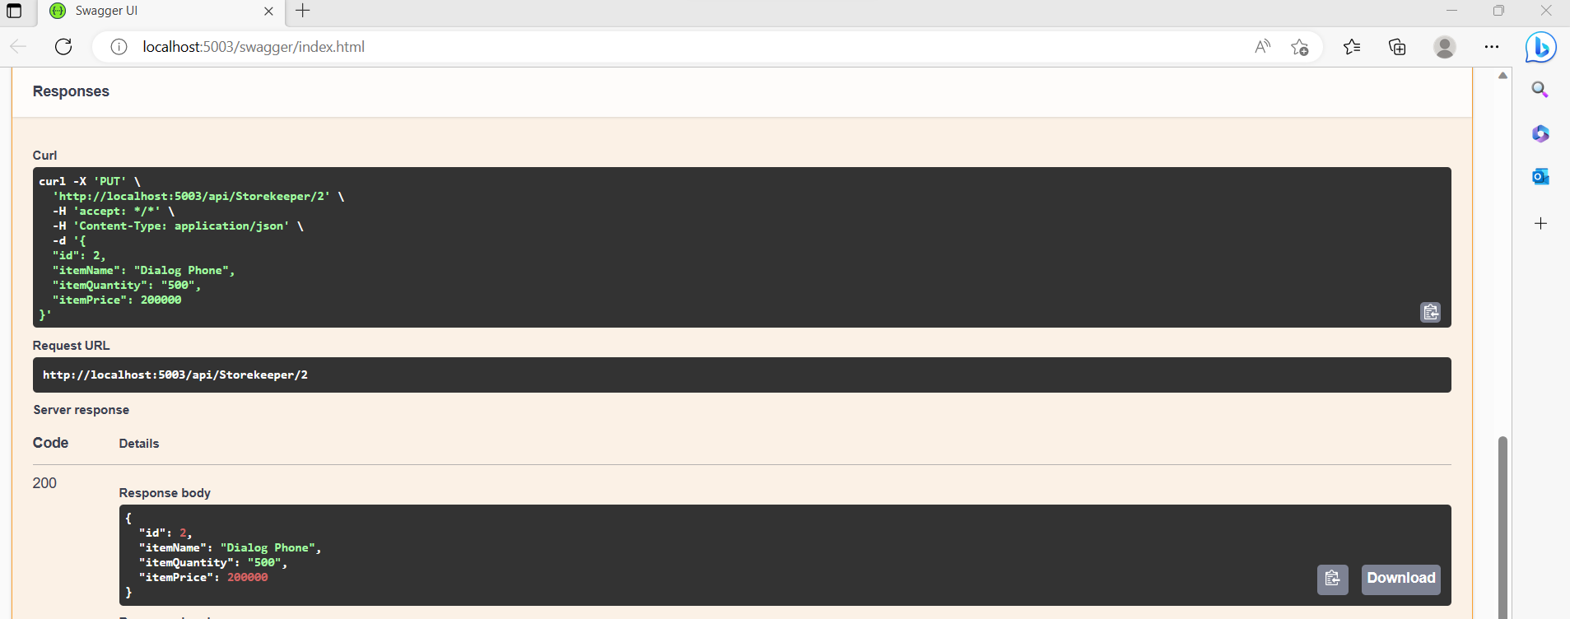
PUT Method

Slide 44
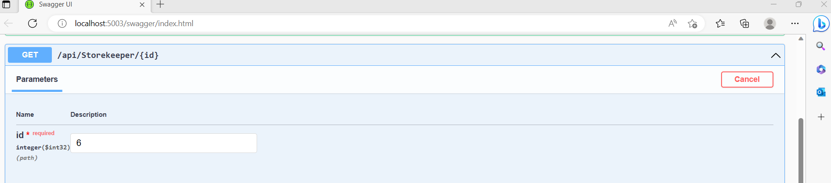
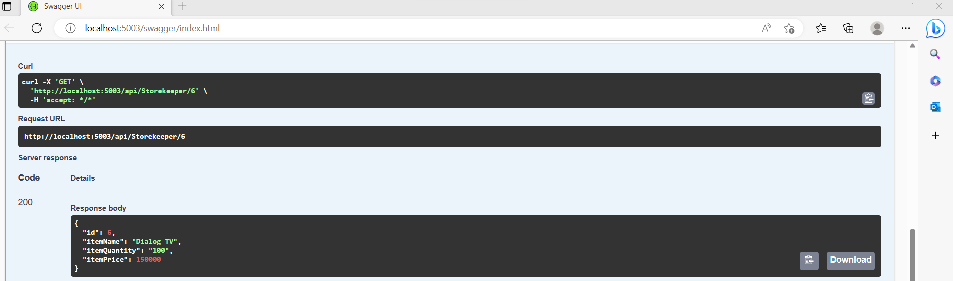
SEARCH

Slide 45
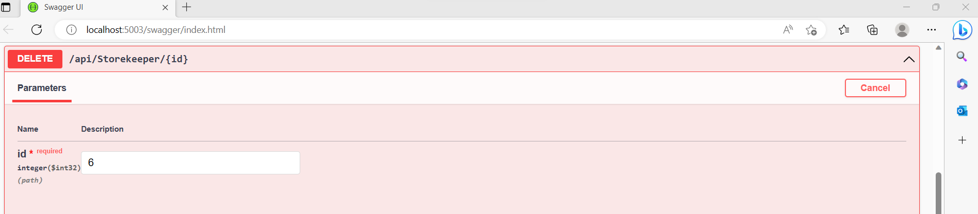
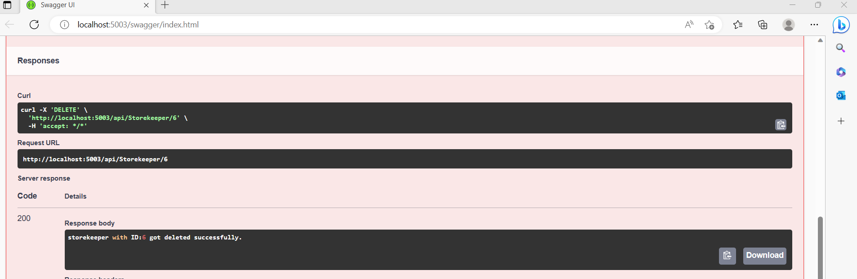
DELETE Method

Slide 46
Gateway project and the API project will both run and open up in two separate browsers.
Gateway:

Slide 47
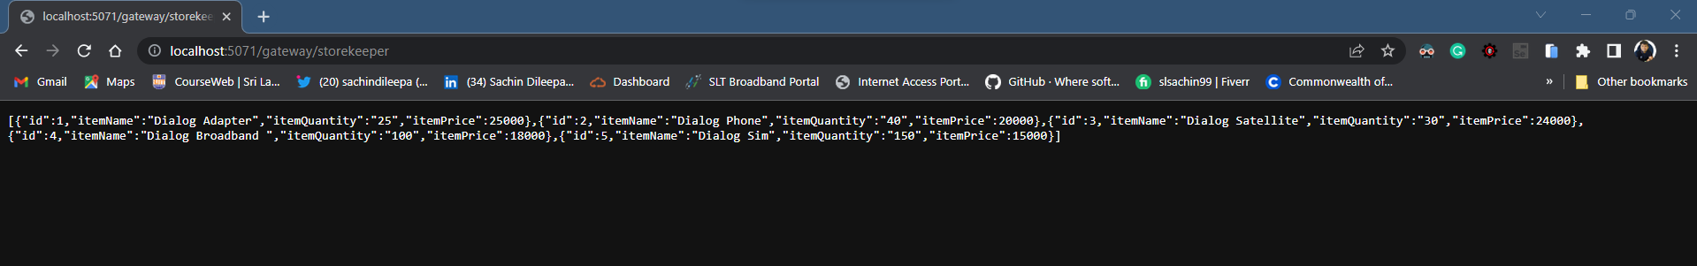
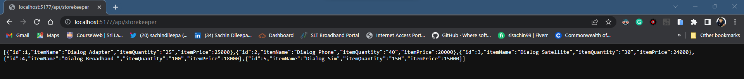
Test the upstream URL in browser.
Test the downstream URL in browser.

Slide 48
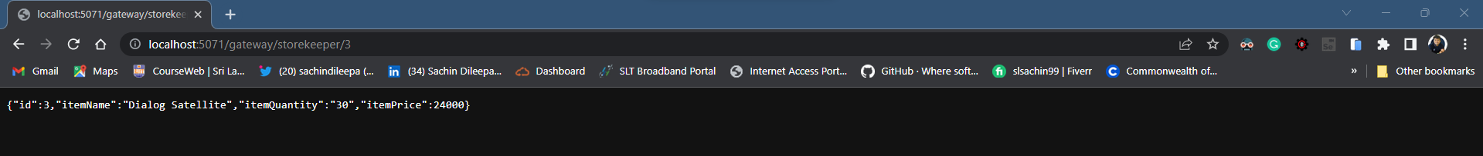
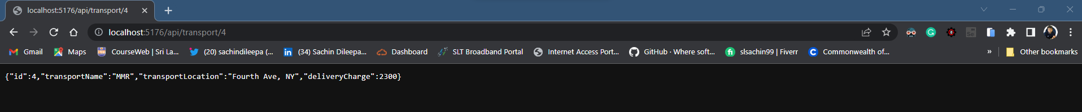
Test the upstream URL in browser.
Test the downstream URL in browser.

Slide 49
IT20081416
Ahamed M.M.Z
Transport Service

Slide 50

Transpoart Service
Elaborate how you can avoid having multiple ports with the gateway you implemented and Solution should have proper folder structure with minimum two microservices and an Ocelot API Gateway.
launchsettings.json in Transpoart service

Slide 51

Ocelot.json in Transpoart service

Slide 52

Screen captures OF Transpoart API

Slide 53

GET Method

Slide 54

POST Method

Slide 55

PUT Method

Slide 56

Search

Slide 57


DELETE Method

Slide 58
Gateway project and the API project will both run and open up in two separate browsers.
Gateway:

Slide 59


Test the upstream URL in browser.
Test the downstream URL in browser.

Slide 60

Test the upstream URL in browser.
Test the downstream URL in browser.

Slide 61
REFERENCES
ASP.NET Core Web API CRUD With Entity Framework - Full Course = https://youtu.be/3NWT9k-6xGg
ASP.NET Core Web API + Entity Framework Core : Database First - EP01= https://youtu.be/CLVJVA9cTuU
ASP.NET Core Web API + Entity Framework Core : REST API Methods - EP03 = https://youtu.be/uPJ2-6YPRjM
ASP.NET CORE Crud operation using Entity framework using swagger= https://youtu.be/RsaUVrg9aNo

